Slide 1
Critical Corridors Development & Infrastructure Solicitation
Informational Webinar
9/2/2025

Slide 2
Agenda
Housekeeping
Background​
Critical Corridors Solicitation
Application Process
Program Highlights
Other Solicitations

Slide 3
Housekeeping
Introductions
Webinar
  Recording will be posted on program webpage
  Press Q&A button below to ask questions

Slide 4
1
Background

Slide 5
Housing and Redevelopment Authority (HRA) Levy
Funding source for:
  Critical Corridors
  Emerging and Diverse Developers (EDD)
  Site Assessment Grants
  FirstHome Down Payment Assistance
First year of HRA levy programs was 2022
Eligibility for these programs limited to HRA area of operation
More info available at ramseycounty.us/HRA
Notes:
Note: “area of operation” includes all of RC with the exception of North St. Paul
*note about: RamseyCountyMN.gov

Slide 6

Notes:
Link to ECI Plan: https://www.ramseycounty.us/sites/default/files/Departments/Community%20%26%20Economic%20Development/Ramsey%20Final%20Report_Pages%2016mar21.pdf

Slide 7
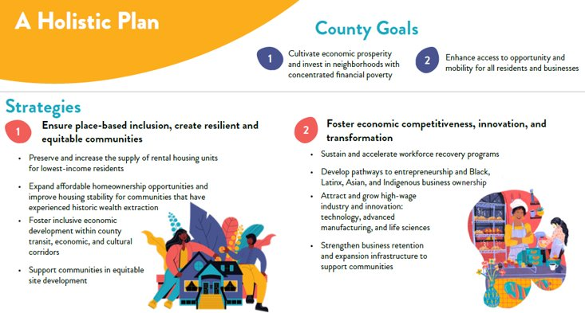

Slide 8
2
Critical Corridors Solicitation

Slide 9
Critical Corridors Overview
Program Goals​
Support redevelopment projects.
Boost connectivity between housing, jobs, retail, services and transportation.
Create more compact, walkable environments.​
Enhance pedestrian access and safety.​
Support vibrant business districts.​
Programs​
Planning​ (Spring 2026)
Commercial Corridor Initiative​ (Spring 2026)
Development & Infrastructure​ (Fall 2025)

Slide 10
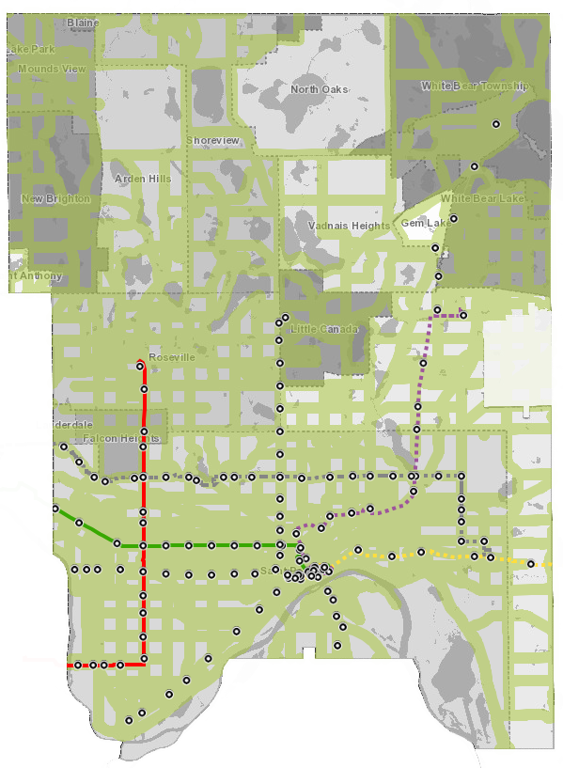

What are Critical Corridors?
Major transportation, economic, and cultural corridors
Critical Corridors are areas that:
  Serve as community hubs for housing, jobs, services, and amenities
  Provide access to daily activities and destinations
  Provide opportunities for wealth creation, economic inclusion, innovation and transformation
New in 2025: downtown Saint Paul is now eligible
See map in program webpage for what’s considered a Critical Corridor
Notes:
Critical Corridors eligibility map: http://ramseygis.maps.arcgis.com/apps/webappviewer/index.html?id=d805105c828349f3aa2d466af5028963

Slide 11

Critical Corridors
Development & Infrastructure
Program Purpose
​Fund inclusive redevelopment and public infrastructure within critical corridors​
Support efficient land use and compact built form to enhance connectivity between housing, jobs, retail and services, while creating walkable environments
Notes:
D&I Guidelines: https://www.ramseycounty.us/sites/default/files/Departments/Community%20%26%20Economic%20Development/2023SAMPLE_CriticalCorridorsDevelopmentInfrastructureApplication-Part1.pdf

Slide 12
Critical Corridors
Development & Infrastructure
Eligible Applicants: developers (for profit and nonprofit), government/public agencies and related development authorities​​
​Maximum Funding Request: $500,000​​
​Timing: Activities must be completed by 12/31/2027. Activities completed prior to grant award are not eligible for reimbursement.
Notes:
D&I Guidelines: https://www.ramseycounty.us/sites/default/files/Departments/Community%20%26%20Economic%20Development/2023SAMPLE_CriticalCorridorsDevelopmentInfrastructureApplication-Part1.pdf

Slide 13
Eligible Activities
Extraordinary/hard construction costs of housing, commercial or mixed-use redevelopment projects.
  Site preparation (clearing, grading, and installation of streets or utilities).
  Public realm improvements or amenities (publicly accessible spaces on private property).
  Stormwater management.
  Geotechnical soil correction.
  Adaptive reuse of buildings.
  Building & related structures removal (demolition, deconstruction and clearance).
  Parking removal associated with redevelopment (resulting in a net decrease of at least 10% of parking).
Public site infrastructure improvements
  Water, sewer, sidewalks, exterior public lights, etc. that support redevelopment
  Improvements not associated with a development project must be comprehensive (improving a single sidewalk/streetlight is inadequate).
For Local Units of Government Only: Strategic property acquisition
  Eligibility limited to agencies preserving sites for future higher density development

Slide 14
Ineligible Activities
Administrative staff time.
Building interior renovation.
Environmental remediation (including soil and groundwater).
Streetscaping or landscaping.
Tenant relocation costs & improvements.
Conceptual design services, legal fees or other soft costs, contingencies and administration.

Slide 15
Prevailing Wage
The Ramsey County Prevailing Wage Ordinance applies to any County funding over $25,000 that includes construction labor hours.

Slide 16
Scoring & Evaluation
Project Outcomes & Opportunity
Placemaking & Transit-Oriented Development
Community Engagement & Racial Equity
Capacity & Readiness
Overall Application
See program guidelines on program website for more details.
Parity in overall Housing Redevelopment Authority levy funding between Saint Paul and suburban cities is also considered.
Notes:
1. Project Outcomes & Opportunity
• Leads to greater intensity of land use.
• Catalyzes development in the area.
• Creates deeply affordable housing.
• Provides essential infrastructure for redevelopment.
• Provides job/entrepreneurship opportunities, particularly for racially & ethnically diverse communities.
2. Placemaking & Transit-Oriented Development
• Increases connectivity to jobs and amenities.
• Addresses existing gaps in the bicycle and pedestrian transportation system.
3. Community Engagement & Racial Equity
• Community-led or driven.
• Gives decision making power to communities most disproportionately harmed by disinvestment.
• Robust community engagement and outreach.
4. Capacity & Readiness
• Feasibly be completed by December 31, 2026.
• Team has sufficient experience to complete project.
• Financially feasible and has reasonable costs.
• Demonstrates need for Ramsey County funding.
5. Overall Application
Overall alignment with Critical Corridors program goals and priorities, as well as alignment with Ramsey County plans:
• Economic Competitiveness & Inclusion Plan.
• Equitable Development Framework.
• Ramsey County Strategic Plan.
• Ramsey County Bike and Pedestrian Plan and All Abilities 2050 Transportation Plan.
• Climate Equity Action Plan.

Slide 17
3
Application Process

Slide 18
Application Process
New application portal: Neighborly​
  https://portal.neighborlysoftware.com/RAMSEYCOUNTYMN/Participant
  Walk-through
  Pre-application meetings: optional but highly encouraged​
Key dates​
  Solicitation open: Tuesday, September 2, 2025
  Solicitation close: Tuesday, October 14, 2025
  Award decisions: December 2025

Slide 19
Application Attachments – Required Materials
Map of proposed project area.
Proposed site plan layout or renderings.
Financial proforma (MHFA multifamily workbook encouraged, otherwise Excel document preferred).
  Detailed project budget.
  Sources and uses.
  Operating expense projections.
  15-year proforma projections.
  Detailed housing unit breakdown, if applicable.
  Occupancy/fill projections.
Project schedule.
Evidence of site control.

Slide 20
Application Attachments – Additional Materials
Waste management plan.
  Required if project includes building demolition or deconstruction.
Municipal resolution in support of the project.
  Required for disbursement of funds if awarded.
Architectural drawings, if available.
Market feasibility analysis, if available.
Photos of project site, if available.
Letters of community support, if available.

Slide 21
Solicitation closes
Tue, October 14
Award Decisions
December 2025
Solicitation opened
Tue, September 2
Activities must be completed
December 31, 2027
Application Timeline
Pre-application meetings

Slide 22
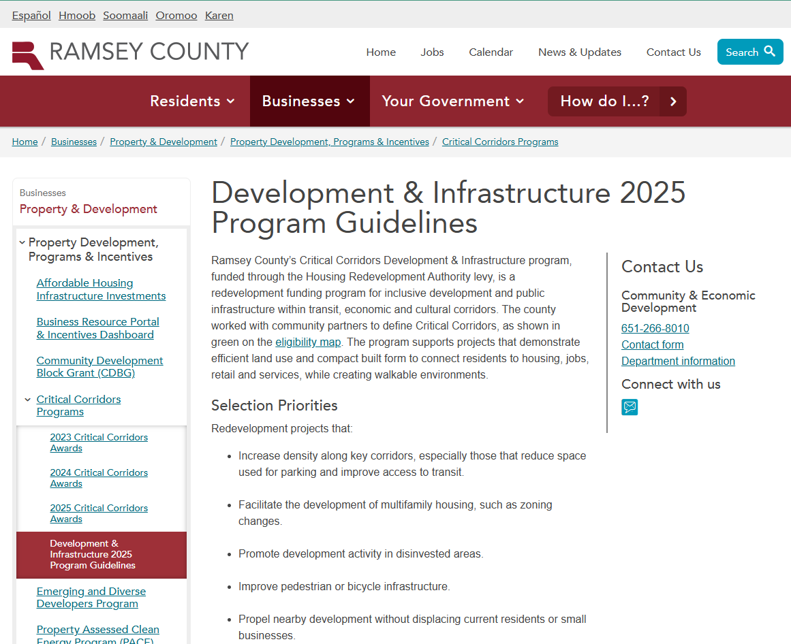
Resources
Program webpage: ramseycounty.us/CriticalCorridors
Program guidelines
Examples of funded projects
Sample application forms
Link to Neighborly
FAQs

Slide 23
4
Program Highlights

Slide 24
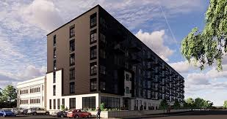
Previous Awards
Marshall Avenue Flats
PAK Properties
Funded activities: site preparation, stormwater management, infrastructure improvements
Alignment with Critical Corridors:
  Transforms a surface parking lot into 98 units of affordable housing.
  Increases density and more pedestrian-friendly.
  One block away from an A line bus rapid transit (BRT) stop, B Line BRT stop and adjacent to an existing bike lane along Marshall Avenue.
  Creative shared parking agreement with the adjacent office building to reduce the overall number of parking stalls on the site.
Status: completed construction in Spring 2025

Slide 25
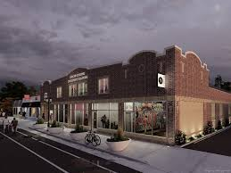
Previous Awards
Little Africa Plaza
African Economic Development Solutions
Funded activities: upgrading the water line to accommodate fire sprinklers
Alignment with Critical Corridors:
  Rehabilitating vacant building along Snelling Avenue into an entrepreneurial space to support emerging and existing African entrepreneurs.
  Mixed-use function: “micro-retail" boutique-style spaces for vendors, community rooms, event spaces and more.
Status: in the process of launching exhibit space for a pan-African museum and an African grocer in its commercial space

Slide 26
5
Other Solicitations

Slide 27
Other CED Solicitations Opening Soon
Emerging and Diverse Developers (EDD)
Application period: September 8-October 31, 2025
ramseycounty.us/EDD
Informational webinars (In-person):
  September 3, 2:30-4:00 p.m.
  September 18, 3:30-5:00 p.m.
  Event details: Check EDD program website at ramseycounty.us/EDD

Slide 28
Other CED Solicitations/Info Sessions
Environmental Response Fund (ERF)
Application period: September 15-November 1, 2025
ramseycounty.us/ERF
Site Assessment Grant (SAG)
Rolling applications
ramseycounty.us/SAG
Brownfield Redevelopment Funding Info Sessions
Hosted by DEED, Met Council, Hennepin, and Ramsey Counties
  Wednesday, September 3, 2-3 pm, Plymouth City Hall
  Thursday, September 4, 10-11 am, Inver Grove Heights City Hall

Slide 29
Questions?
Ramseycounty.us/CriticalCorridors
Ella Mitchell, ella.mitchell@ramseycounty.us
Carmel San Juan, carmel.sanjuan@ramseycounty.us

