Slide 1
Learn & Earn
Vendor Orientation
June 5, 2023

Slide 2
Agenda
Purpose
Introductions
WFS Director Welcome
Branding & Marketing
Participant Eligibility & Documentation
Participant Exits
Program Reporting
Participant Compensation
Invoicing
Monitoring

Slide 3
Purpose of Orientation
Begin a new relationship with your organizations via our ARPA Learn & Earn funding with shared goal of supporting our residents
Ensure that partners have support, resources, tools that they need
Relationship focused contract management style

Slide 4
Introductions
Ramsey County team
Saint Paul team
Vendor Introductions
  In the chat
  Have opportunities for everyone to meet in person soon! ☺

Slide 5













Slide 6
Welcome
Ramsey County Workforce Solutions

Slide 7
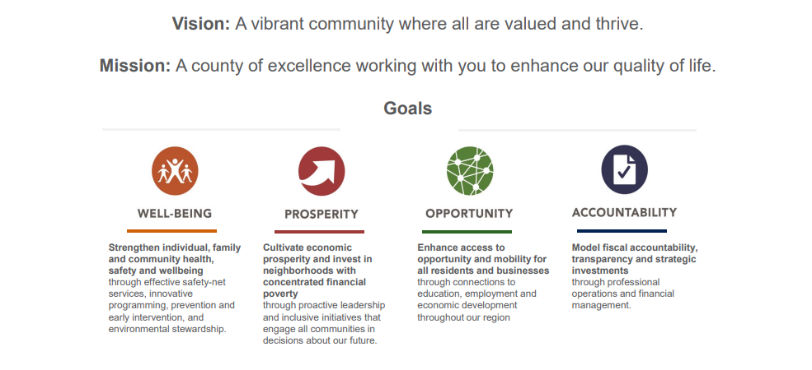
Ramsey County Vision and Mission
Notes:
Ling

Slide 8
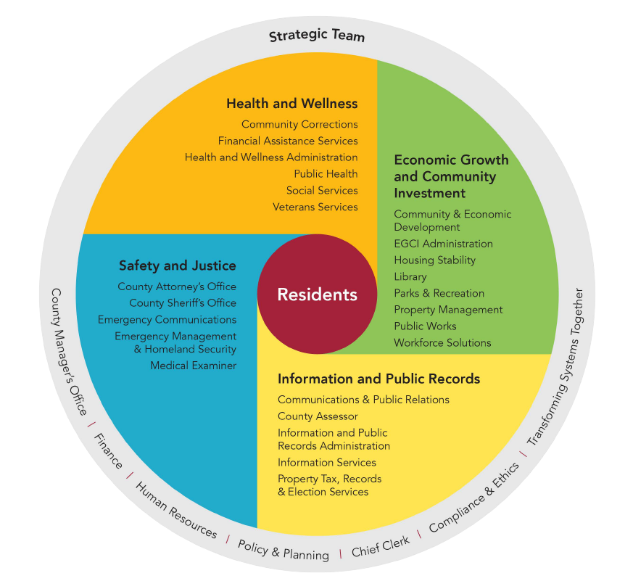
Ramsey County Organization Structure
Notes:
Ling

Slide 9
What is Workforce Solutions?
Workforce Solutions provides employment and training services to job seekers and businesses in Ramsey County (including St Paul)
We have nearly 80 employees to do this work in addition to a variety of community partners.
CareerForce Center in the Ramsey County located at Fairview/University. Additional Community Career Labs at East Building and Maplewood Library.
Who We Serve:
  Serve residents who are enrolled in eligibility-based programs.
  General job seeker looking for resources through Career Labs, by phone, virtually and events.
Notes:
Ling

Slide 10
WFS Commitment to Partnership
Philosophy of contract partnership rather than contract management.
Thank you for your partnership.
We do not do this work alone.
WFS committed to your success and the success of our community.
There are no things that are too little or too big to discuss.
Notes:
Ling

Slide 11

American Rescue Plan Act (ARPA)
Federal funding, in response to COVID, for transformational change
$24.8 million combined in ARP funding for high-quality job training programs and workforce initiatives throughout Saint Paul and Ramsey County.
$10 Million for Learn and Earn RFP
Notes:
Ling
Collectively, Ramsey County and Saint Paul are co-investing nearly $25 million into workforce development initiatives to fill gaps in the current workforce ecosystem. These investments, focused primarily on serving job seekers ages 18-30, are funded by the American Rescue Plan Act (ARPA).

Slide 12
Background
Ramsey County’s strategic priorities Intergenerational Prosperity for Racial & Economic Inclusion.
Committed to creating pathways to intergenerational prosperity with an emphasis on Black/African American, American Indian and other racially/ethnically diverse communities.
County wide approach focuses on racial and economic inclusion with intentional and strategic investments in residents and businesses.
Notes:
Ling

Slide 13
Why Learn & Earn Initiatives?
Align our future workforce with the opportunities that labor market information identifies as in-demand
Our young people are an economic asset for investment
Young people need basic needs met to engage in career growth
Moves toward achieving outcomes identified in the Economic Competitiveness and Inclusion Plan
Notes:
Ling

Slide 14
Learn & Earn programming is defined as:
Employment and professional development opportunities and programming in which participants learn career-readiness skills, specific occupational skills, entrepreneurship skills, financial education skills, and other employment or life skills.
Participant may achieve certificates or credentials through these educational and training programs.
While participants are learning, they are compensated for their time and/or efforts dedicated to learning.
Notes:
Ling
Learn and Earn focused workforce development programming is an intentional strategy toward economic inclusion through community investment.

Slide 15
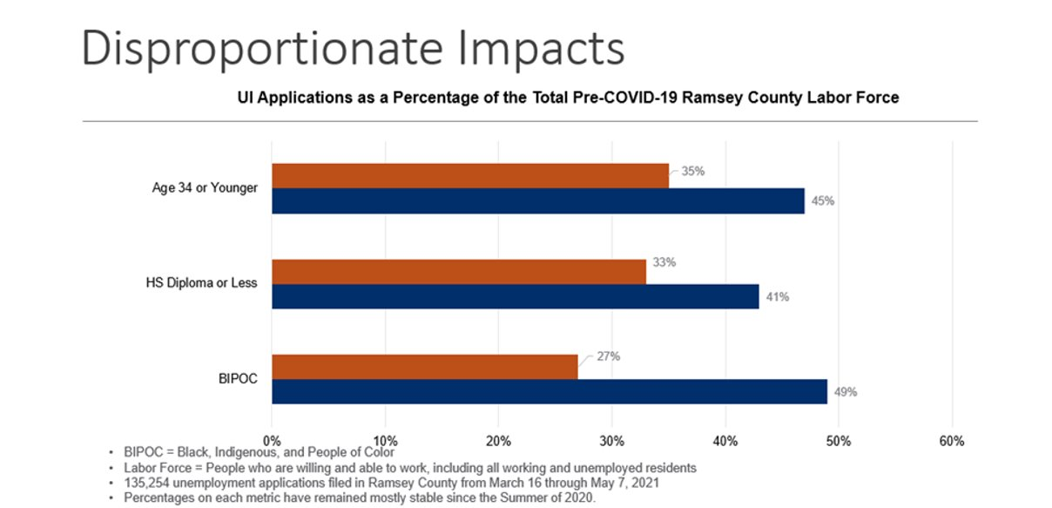
Why Young Adults?
Nearly 50% of Ramsey County residents are ages 17-34
Economic “scarring” of loss of job prospects has long term impacts on young people
Notes:
Ling

Slide 16
Branding/Marketing

Slide 17
Press Event & Announcement
Final week in June
All CBOs should be in attendance
Will be inviting federal delegation, local elected officials, and others
Followed by press release with all organization information

Slide 18
Ramsey County Webpage
Creating a Ramsey County Learn & Earn webpage with all program information
Please provide referral contact/pathway to have listed on webpage, along with timing/frequency
Notes:
Rachael

Slide 19
Branding & Marketing
“Contractors follow County branding and marketing standards, including use of Ramsey County and any affiliated logos and graphics. All marketing materials funded in the contract will require County approval plan.”
We will provide logos for use
“In partnership with Ramsey County and Saint Paul…”
Provide materials for review in advance of public promotion (including social media posts)
All costs for marketing should be “reasonable”
Notes:
Rachael

Slide 20
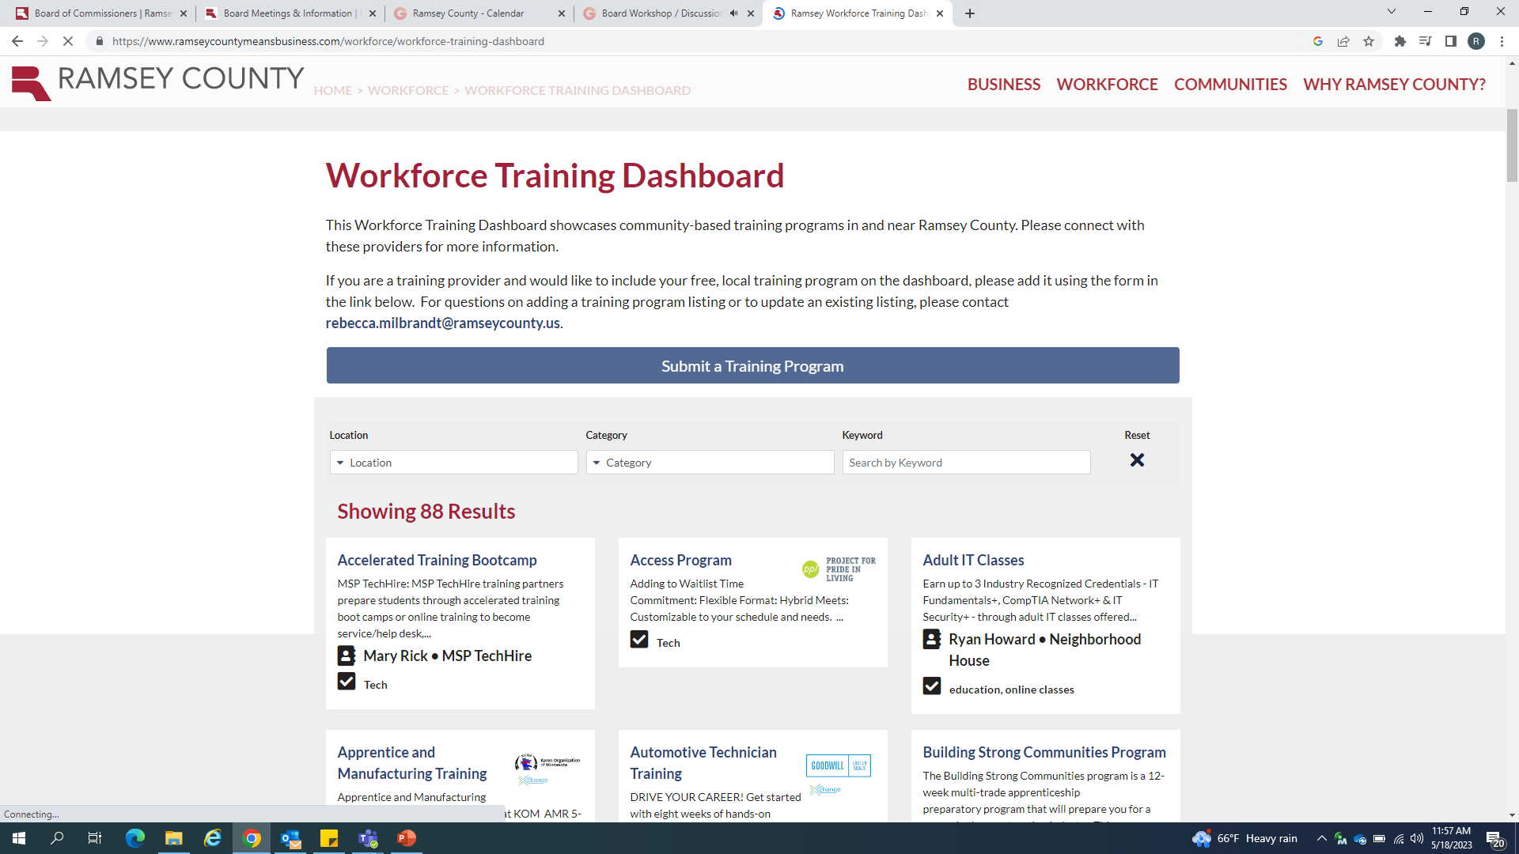
Ramsey County Means Business
Please submit all program to the RCMB Training Dashboard
Notes:
Rachael

Slide 21
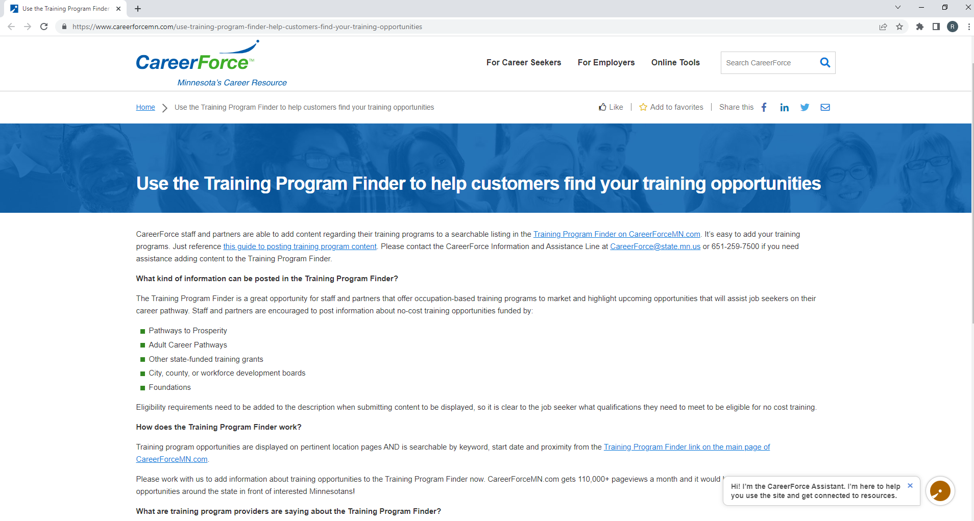
CareerForce Training Program Finder
Please submit all programs to the CareerForce Training Program Finder tool
Notes:
Rachael

Slide 22
Ongoing County Engagement

Slide 23
County Engagement
Participate in open info sessions/orientations to the Learn & Earn programming
Group technical assistance & support community
Ongoing 1:1 technical assistance
Rachael | Kristi
AEDA | CEE
AEDS | Goodwill Easter Seals
Bridgemakers | Hack the Gap
Merrick Entrepreneurship | New Vision Foundation
Merrick Human Services | Twin Cities Rise
Spark-Y | Minnesota Training Partners
 | Tree Trust

Slide 24
Participant Eligibility & Documentation

Slide 25
Participant Eligibility
Ramsey County resident
  If experiencing homelessness, must be connected to Ramsey County
Age 18-30 at the time of enrollment
Preference to:
  Low-income
  Barrier to employment/education
Notes:
Rachael

Slide 26
Participant Enrollment
Need to collect, record and store:
  Participant name & contact info
  Participant gender
  Participant race/ethnicity
  Participant age
  Participant address w/ zip code
Pre-Program Participant Survey
  Survey link
Individual Development Plan
Notes:
Rachael

Slide 27
Individual Development Plan
All programs will need to complete IDPs with each participant
  Goal Plan that details strengths, potential challenges, and how programs will provide supports to help with goal accomplishment
  Will provide a template to use
Notes:
Rachael

Slide 28
Participant Exits

Slide 29
Participant Exit
Collect any information regarding training/education accomplishments
Collect any placement/employment information
Have participants collect Post-Program survey
  Survey link
Notes:
Rachael

Slide 30
Program Reporting

Slide 31
Monthly Program Report
Submit with invoice
Includes narrative updates & cumulative quantitative data
  Total participants served (gender, race, city)
  Any program outcomes
    Program completion
    Completed certificate or credential
    Entered employment
    Engaged paid internship
    Received stipend
    Received start-up funds
Notes:
Rachael

Slide 32
Participant Compensation

Slide 33
Participant Compensation
Stipends: Should be provided to participants while they engage in skill development and/or training programs. Stipends amounts and distribution timelines should be pre-determined and information about the stipends should be made available to participants prior to beginning the program/training.
Wages: Should be paid to participants as compensation for time worked on a job, internship, or work experience. Organizations providing wages to participants must be able to administer payroll for participants. This includes providing worker’s compensation and other liability insurance and can be paid for with contract funds.
Start Up Grants/Funds: Should be paid to participants as dictated in plan after completion of activities. Your organization should have some way to track that funds were used for business costs
Notes:
Rachael

Slide 34
Participant Compensation
Wages: Taxable income. Payroll taxes, etc. taken out of check. Minimum wages $15.19/hour. If lower, please consult with RC
Stipends: Taxable income, but tax implications do not come into play until after $600/year. Generally, participants as “contractors”
Start Up Funds: Taxable. Encourage organizations to consult your counsel about seed funds to entrepreneurs
*still seeking clarification from MN DHS about income on state benefits
Notes:
Rachael

Slide 35
Budgets & Invoicing

Slide 36
Yearly Budgets
Due to duration of contracts, we are going to break up budgets by year
Complete a planned budget for 5/26/2023-5/31/2024 for invoicing. Return by 6/16.
Helpful for short-term programmatic planning & monitoring
Reminder: funds must be obligated by Dec 2024
Notes:
Rachael

Slide 37
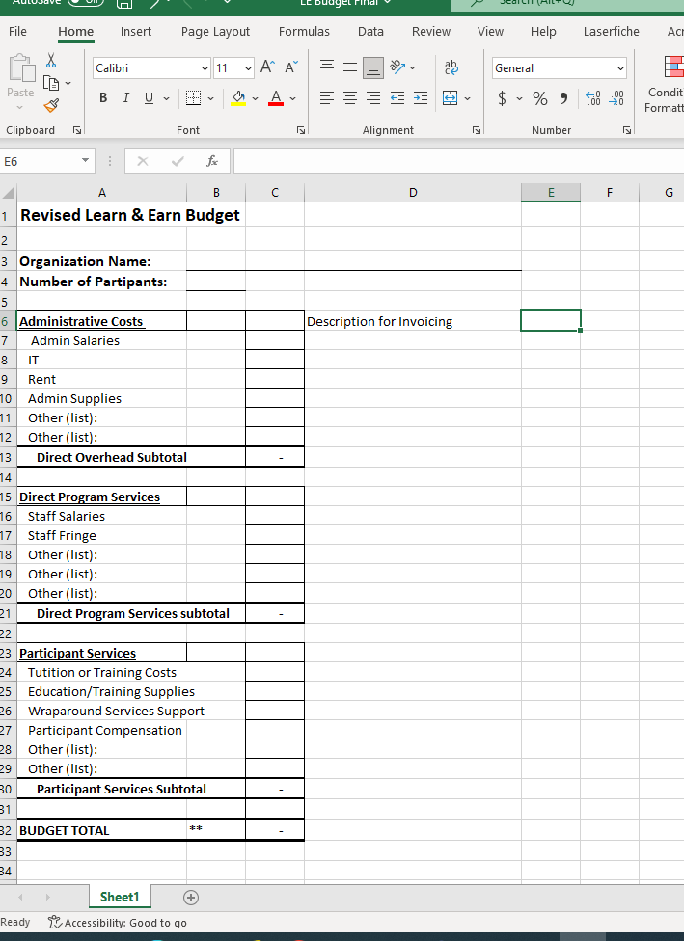
Notes:
Rachael

Slide 38
Cost Categories
Admin: accounting, rent, payroll functions, etc.
Youth Participant Compensation Benefits: Wages and stipends paid directly to young people engaged in program activities
Direct Services to Youth: Costs associated with providing direct services to youth, staff costs
Training and Education: Costs associated with providing education and training, including tuition, customized training, technology, supplies, equipment required for training
Support Services: Reduce barriers, i.e. transportation, clothing, tools, child care, housing/rental assistance, school supplies, etc.
Notes:
Rachael

Slide 39
Payment Methodology
  Cost reimbursement basis
    Expenses must have been incurred before it can be reimbursed
  Only expenditures made in accordance with the approved budget in your contract will be paid.
    If you need a modification, you need to work through process with Katie. Some modifications may require WFS staff sign-off.
  All costs and expenditures must occur during the contract period which is the date the contract signed by all parties or start date in the contract whichever is later.
  Financial records should be maintained through an accounting system which sufficiently and properly reflects revenue and all direct and indirect costs of any nature incurred in the performance of the Agreement.
Notes:
Katie

Slide 40
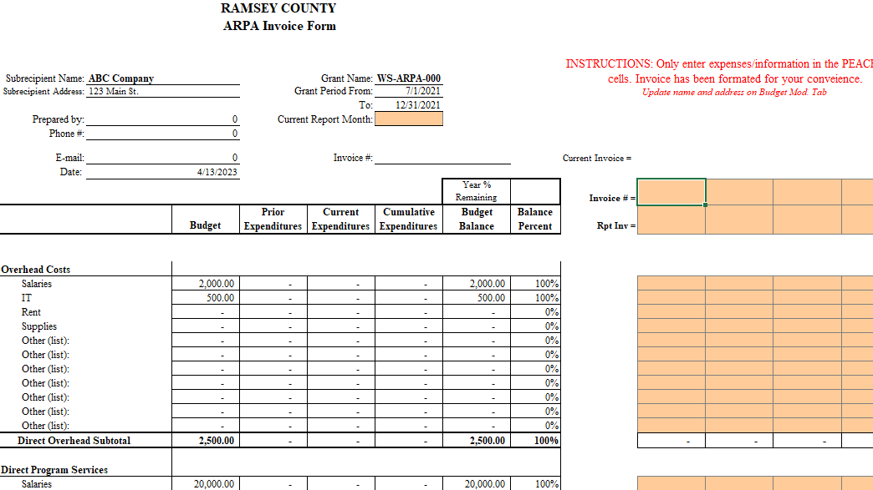
Monthly Invoice Workbook
Notes:
Katie

Slide 41
Payment
  Invoices are due no less than monthly by the 15th of the following month
  Invoice must be signed by the Contractor’s authorized official. Electronic signature or typed in name acceptable.
  All invoices must be signed and sent as an attachment to the e-mail RCVendorInvoices@co.ramsey.mn.us and cc Katie
  All invoices must be submitted using Ramsey County’s authorized Invoice form. Payment will be made for actual costs incurred during the invoicing period.
  One invoice per email if you do fall behind
  Subject line of email must read:
  Contract ID, Vendor Name, Period of Invoice
  Ex: WFS-ARP-0025, ABC Company, July 2023
  Back-Up Documentation Required For All Invoices
Notes:
Katie

Slide 42
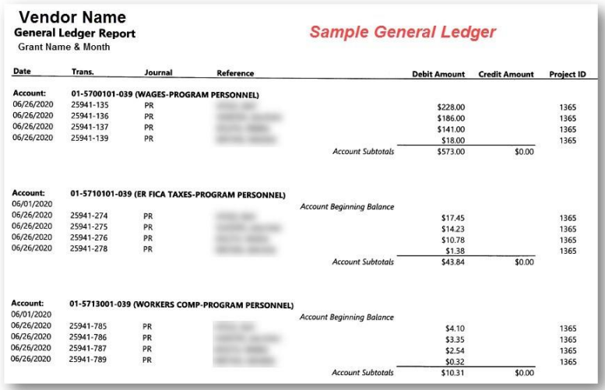
Back-Up Documentation
  Option #1 – Detailed General Ledger Generated by Accounting Software
  Option #2 – Receipts/PayStubs & Time Cards for all expenses
Notes:
Katie

Slide 43
Payment Schedule
    Per the terms of your contract, Ramsey County has 35 days from the receipt of your invoice to issue payment. However we try to process them as quickly as possible
    Direct Deposit is encouraged but checks will be cut until that is set up –
      ACH form required for those not on already direct deposit – please contact Katie if you need to get this set up
Notes:
Katie

Slide 44
Support Service Tracking

Slide 45
Participant Support Services
  Costs for services and items considered reasonable and necessary for a participant to remain in the program
  Participant Support Service may include:
    – Transportation such as bus card, gas card or essential car repair
    – Books and/or tools needed for the training or job
    – Clothing/uniform for work
    – Interview clothes
    – Supplies necessary to meet program needs, i.e. laptop, cell phone
Notes:
Katie

Slide 46
Participant Support Services
  Participant Support Service must be in the approved budget
  Contractor should have a support service policy delineating types of Support Service, maximum allowed per participant and process to request
    Policy must be shared with all participants
  Participant must sign for all Support Service received
  Reimbursement for gift cards/other support come AFTER distribution to participant
Notes:
Katie

Slide 47
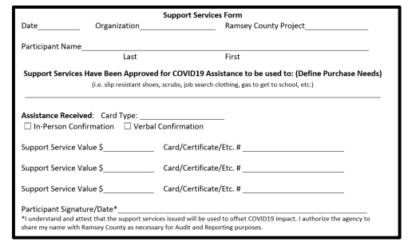
Support Service Tracking
  Requirement to track and document support services
  Participant support service confirmation form required
Notes:
Katie

Slide 48
Participant Supplies - Electronics
  Includes items that are less than $5,000 in value, i.e. laptop, cellphone, etc.
  Budgeted in the approved contractor budget
  Expenditure for participant supplies must be
    Necessary; aligns with the objectives/goals of the program
    Reasonable; costs do not exceed what would be incurred by a prudent person under prevailing circumstances
  Participant must sign for all supplies received
  Supplies provided to participants must be tracked
Notes:
Katie

Slide 49
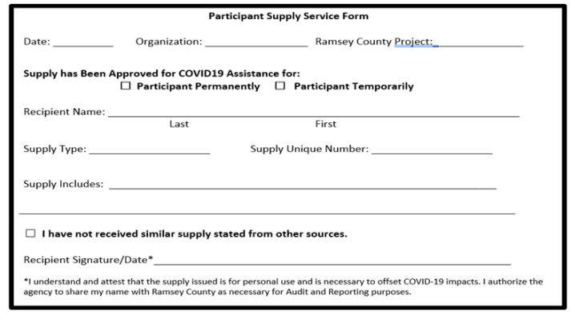
Participant Supplies Tracking
  Requirement to track and document supplies
  Participant supplies confirmation form required
Notes:
Katie

Slide 50
Monitoring

Slide 51
Subrecipient Monitoring
  Monitoring is to ensure the success of your organization and to prevent issues
  Help identify additional training needs or Technical Assistance
  Track progress in meeting program outcomes
  Monitoring may take the form of:
    Check-in Calls
    Completing and submitting written Monitoring Guide
    Tracking of progress towards monthly outcomes
    Reviewing Financial and Programmatic Reports
    Site Visits
  Monitoring with begin in a few months, starting with an Entrance Meeting to explain the process and timeline and answer any upfront questions
Notes:
Katie

Slide 52
Subrecipient Monitoring
  Key Monitoring Tips!
  Know your contract! Please read though and be familiar with your contract language. You will be asked about meeting the contract requirements as a part of monitoring.
    Per standard contract language, Background Studies are required for all staff, volunteers, mentors, and sub-contactors who have contact with clients.
  Document, document, document! Keep receipts, time sheets, invoices, client files with notes, etc. Even if they are not things we're asking you to submit with invoices. For audit or monitoring purposes, you may be asked to make financial statements, documents, records, case files, accounting procedures and practices available upon request to the County, the State Auditor, or the County's ultimate funding source (e.g. the feds!) for 6 years after the contract ends.
  If you have a question, no matter how big or small, please ask!
Notes:
Katie

Slide 53
THANK YOU!
We look forward to your partnership!
Rachael Molenaar – rachael.molenaar@ramseycounty.us
Kristi Cobbs- kristi.cobbs@ramseycounty.us
Katie Wollach- kathryn.wollach@ramseycounty.us
Notes:
Rachael

