Slide 1
Good Food Purchasing Twin Cities, MN: Creating Equity through Food Purchasing
Notes:
Zoe Intro: Hello and Thank you for having me today. My name is Zoe Hollomon. Provide Food Justice, Food Policy background.
Now I work with local partners around the state in the Good Food Purchasing TC/MN Coalition. We work together to make institutional food purchasing more responsible. we are bringing people together to understand and influence how public dollars are spent at institutions to purchase food, where a lot of our communities get their food (schools, hospitals, convention centers, govt agencies that buy and serve food in programs for the community.) part of a national effort based on 5 core values, with key tools and technical assistance, we believe this model will help us make the food system more transparent, equitable and accountable.

Slide 2
Notes:
For all of you new to the Good Food Purchasing Program-
The Good Food Purchasing Policy/Program (GFPP) is a national movement, based in the work of local coalitions, to change the ways food is purchased at institutions to reflect five core values: local economies, environmental sustainability, valued workforce, nutrition and animal welfare.

Slide 3
Notes:
The origins of Good Food Purchasing are in Los Angeles, where in early 2000s local communities and their food policy council organized to create a model that could create changes in institutional food spending, hundreds of millions of dollars each year, its also goes through complex systems and regulations that exist around food service. Over years they worked with partners (unions, farmers, health and environmental justice groups) locally and nationally to create a model that was from their perspectives but would have the ability to change institutions.
These impacts that have come as a result of their work with LAUSD and their City govt since policy adoption in 2012, implementation and organizing have created many benefits for local communities.

Slide 4
Notes:
At the core of Good Food Purchasing model is 3 things-an assessment, a set of purchasing standards and policy. Institutions take an assessment each year to evaluate their food purchasing choices. The standards teach institutions and us how to look at what they purchase and guide them towards options that are better for our communities. Some “local purchasing” models only look at a few of these areas but Good Food Purchasing looks at 5 and all equally, as they all impact our communities. Policy adoption helps make changes long lasting and creates accountability.
Together Coalition partners and institutions can better understand eachothers needs, and set goals and make changes in purchases over time.

Slide 5
Notes:
Using this measurement system, each institution can get up to 5 points per category based on their purchases and the companies they buy from.

Slide 6
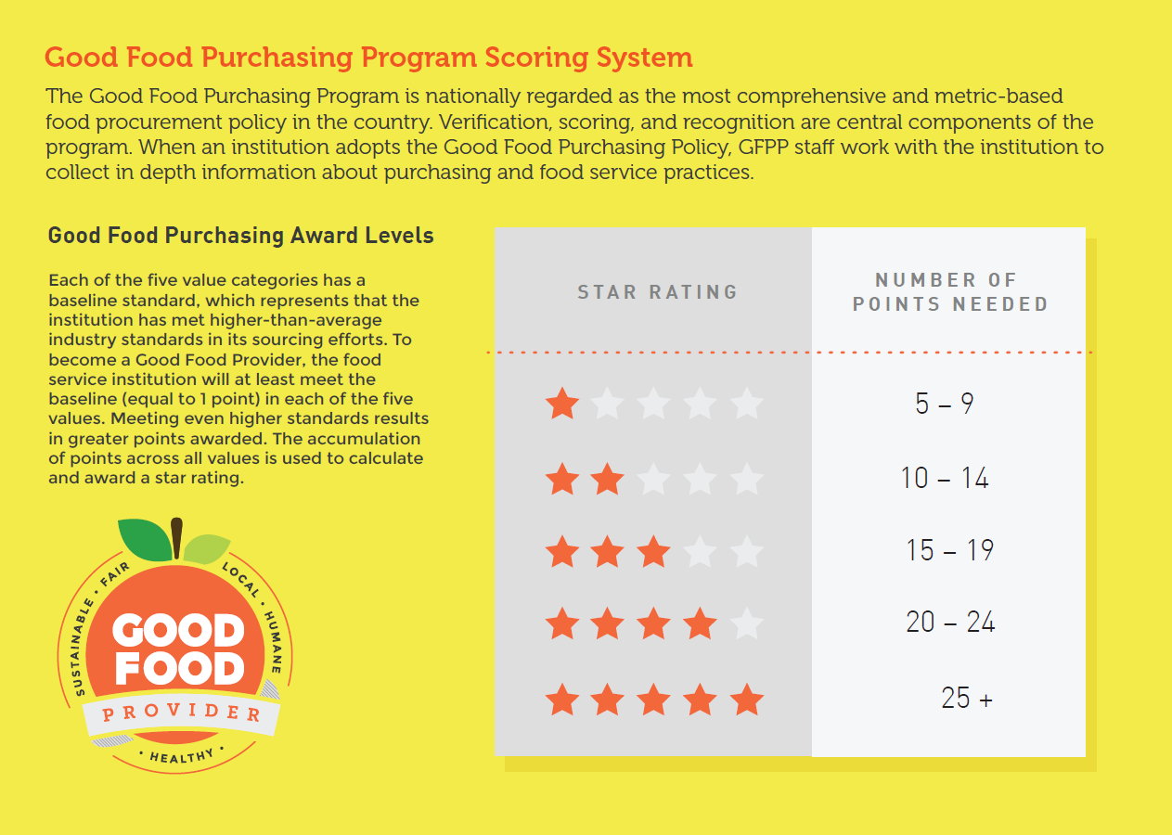
Notes:
We use a Star -based system. With a total 25 possible points in each value category (standards and bonus points). This system was created to help institutions and coalitions create measurable goals that can gauge positive impacts for our communities.

Slide 7
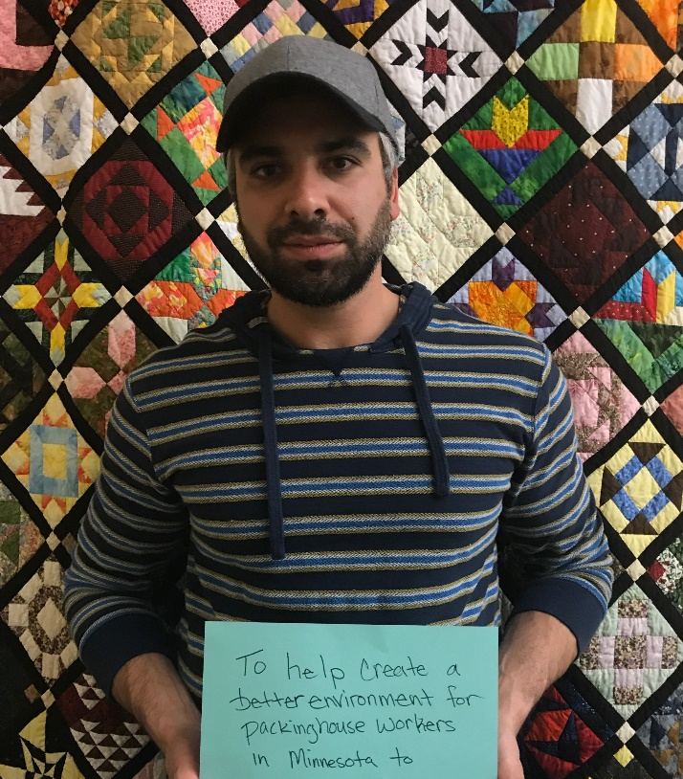
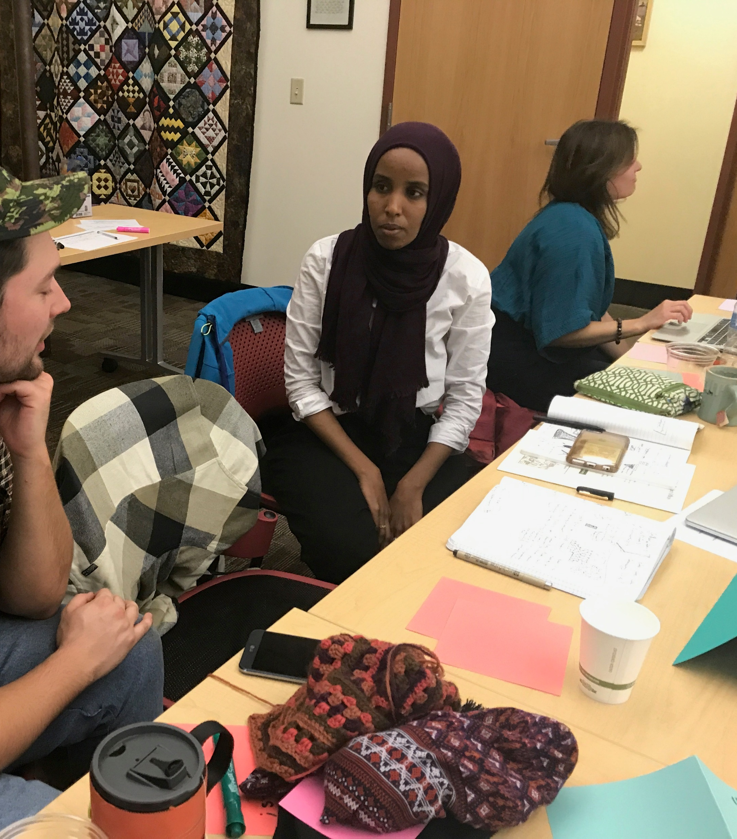
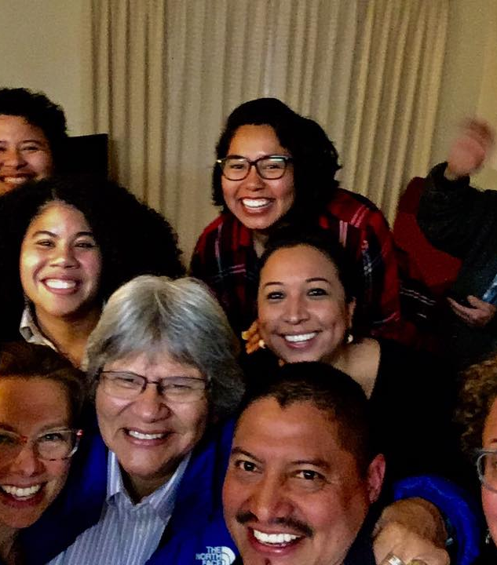
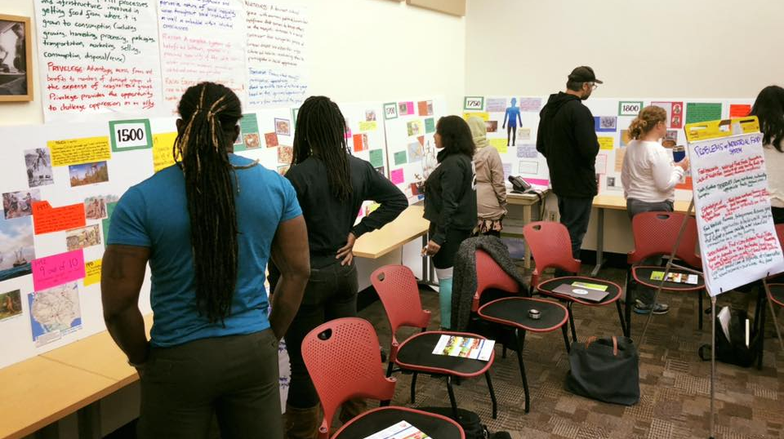
Good Food Purchasing TC/MN
Est in 2016
Exploring Food Purchasing at Institutions and impacts in our communities
Purpose: Bring people together to make changes in spending that are meaningful to our communities.
Notes:
Our local coalition came together in Nov. 2016 to learn about how different institutions, buy food and how those decision are impacting our different communities. Whether we’re school students, food and factory workers, communities facing hunger and undernourishment, pollution from toxic chemicals and pesticides, farmers and farm workers, its important to understand how the system impacts us and what the mechanisms for change (contracts, operational procedures, policy, relationships,) are and how to use them for good. We’ve learned a lot and we still are learning.
–Our coalitions purpose is to bring people together to understand how institutions work and to work together to make changes in policy and procedure that are meaningful for our communities.
More local produce and products purchased,
better working conditions for food factory workers,
less toxic chemicals in our foods and our communities,
healthier and better tasting food
Etc.

Slide 8
Local coalition working to adopt GFPP in Minnesota
Lead Organization: Land Stewardship Project
Local Coalition Partners: Hmong American Farmers Association Institute for a Sustainable Future The Good Acre The Homegrown Minneapolis Food Policy Council United Food and Commercial Workers Local 1189 (St. Paul) & 663 (Mpls)
Minneapolis Public School Culinary Wellness Services St. Paul Public Schools Nutrition Services Pesticide Action Network North America
Stakeholder Organizations
Minnesota Food Association/ The Food Group
Kitchen on the Bluff (LEDC)
University of Minnesota Extension & Metro Food Access Network
Institute for Agriculture & Trade Policy
Centro Campesino
Domestic Fair Trade Association
National Support & Tech. Assistance
Center for Good Food Purchasing
Food Chain Workers Alliance
Real Food Media
America Society for the Prevention of Cruelty to Animals (ASPCA) Pesticide Action Network North America
Notes:
The power of this Good Food Purchasing movement is based in local coalitions and supported by national partners. Local Coalition partners have made formal commitment to GFPP work in the Twin Cities and MN. Stakeholder Organizations are those who were part of our initial meetings and goals setting but have yet to sign-on formally. National partners provide significant resources and tech assistance to help us achieve our goals.

Slide 9
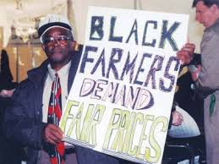
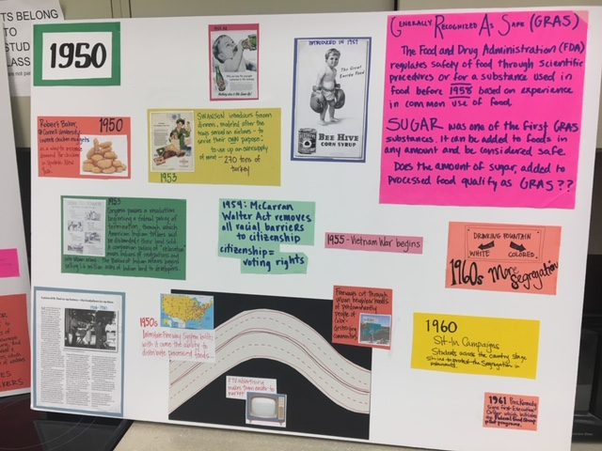
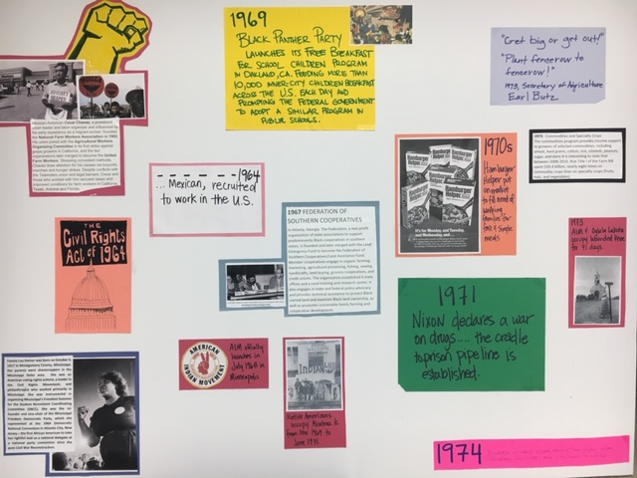
RACIAL EQUITY FRAMEWORK
Land access and relationship with nature,
Cultural heritage & food traditions,
Nutritious food access,
Economic autonomy/wealth building,
Political power/ voice in decision-making/autonomy
Notes:
We’ve been talking a lot about Racial and Social Equity with coalitions in other cities and with our communities here, we’re hearing about issues around access, the loss of culture and traditions, hunger and undernourishment in rural and urban communities, and we know that these inequities aren’t accidental. They are the result of intentional policies put into place over hundreds of years. Like most big systems, our food systems have largely been created to serve a tiny minority of ultra elite people and corporations with immense power, corporate and governmental control. Race and social constructs, policies and procedures have been used to oppress people all throughout the history of our food system and so we must acknowledge them and understand them in order to change them.
We embrace a racial equity framework:
Use the Food Equity Timeline to have some shared knowledge about the history of our food system, the intentionally oppressive policies and decisions that created inequities as well as the legacy of resistance and resilience of indigenous and communities of color in order to change the trajectory.
How do we know what equity in food and health means? We’re not doing food policy work in a vacuum. Its essential to understand how indigenous and POC relationships with these things have been broken and provide guidance for when we talk about creating equity in our food system—it is the restoration and repairing of those relationships and mechanisms.
We’re thinking about the GFPP standards and beyond them for what speaks to our communities, not just orienting our goals, objections, events and activities around the institution we’re working with.
Chicago’s GFPP coalition is making some amazing gains through policy around land use and targeting economic development to address racial economic disparities. They adopted the policy it at the City and Cook County levels and now are implementing it in public schools, parks, at the county jails, and other institutions that fall under those govt level purviews.

Slide 10
We want to invest in institutions that . . .
Stand for healthy, nutritious and culturally appropriate foods
Stand for local farmers and local food businesses.
Stand for Rights for Food and farm Workers.
Stand for sustainable farming and the removal of toxins from our foods and food chain.
Stand for local decision making and transparency in decisions that impact our communities.
Notes:
All campaigns and coalitions have to figure out what they stand for. We’ve been hosting listening sessions, working meetings to look at what our communities need and want and how to make purchasing “Good Food” common place.
Here’s a closer look at what we’ve heard our communities say about what it means to stand for Good Food.
They want to support institutions that:
Stand for healthy, nutritious and culturally appropriate foods in our schools, hospitals and all our communities. We want more from-scratch cooking, less processed foods, foods that are free of hormones and antibiotics and are in touch with our communities cultural needs and preferences.
Stand for local farmers and local food businesses. Our local farms and food enterprises can support our local food needs with greater access to institutional markets and support in fair pricing, land access, training, distribution and support overcoming barriers to farming.
Stand for Rights for Food and farm Workers. The people who pick, prepare, distribute and sell our food deserve fair pay, safe jobs, and the power to organize.
Stand for sustainable farming and the removal of toxins from our foods and food chain. The chemical pesticides and fertilizers that are used in conventional farming harm people, wildlife, soil, water and
Stand for local decision making and transparency in systems. We want institutions to engage local farmers, food workers, parents and youth to have more of a say in the food that we buy and eat everyday.
This is Bertrand Webber, the Director of MPS CWS. They have been an outstanding partner, our first institution to be assessed and are working with us to figure out how to bring more good food to communities through their purchasing. Its not easy work, nor do we have all the answers but we are figuring them out together. We need more institutions like them to step up, partner with us and model change. If we’re going to move beyond talking about how to create equity in reality (our policies and practices) We need people who are willing to walk the walk.

Slide 11
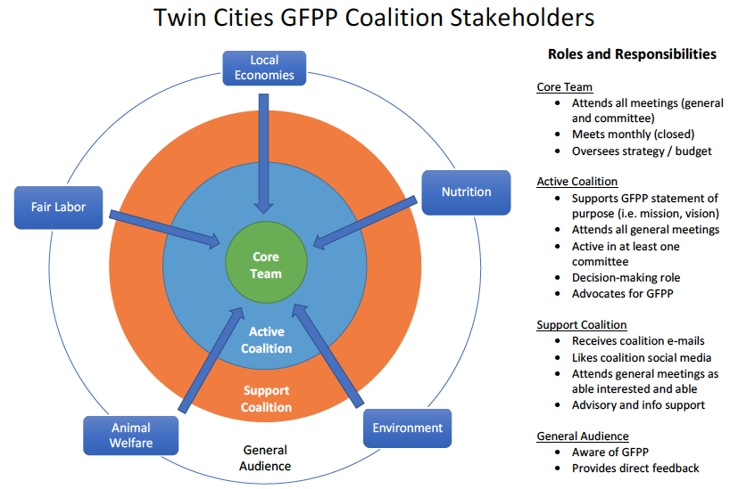
Notes:
In terms of how we work, we have partners and stakeholders at different levels of commitment and engagement.
Core Team- most engaged, leadership team
Active Coalition-includes sign-on partners, more active, vote on decisions, work in committees
Support Coalition-includes sign on partners, provide support and inform our work
General audience- include public, stakeholders, etc.

Slide 12
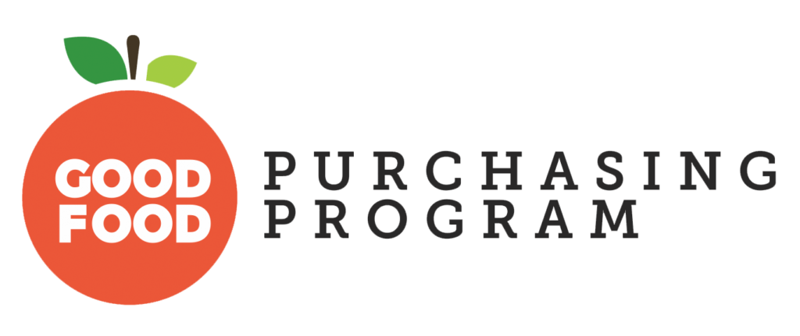
Contact Good Food Purchasing Policy Twin Cities Coalition
Contact: Zoe Hollomon, Coalition Organizer
Email: gfpptwincities@gmail.com
Phone: 716-444-6872
Facebook: @GFPPTC
Web: goodfoodcities.org
Notes:
If your organization is interested in getting involved, there are many ways. Join as a sign-on partner (sign on to endorsement doc) participate in our coalition (at mtgs, on committees, support actions, alerts), join our core team, etc. Most start with a one to one with someone on our core team (Zoe, Terry, Tanya) With all this talk about equity, we are excited to bring a model that is based in local organizing, engages key partners who have the knowledge, technical expertise and values to make changes in our food system.

