Slide 1
ENHANCING ENVIRONMENTAL HEALTH SERVICES
Environmental
Service Center
Notes:
Sara
Hello everyone, I am Sara Hollie, Director of Saint Paul - Ramsey County Public Health.
On behalf of Saint Paul-Ramsey County Public Health, our Environmental Health Division and Ramsey County Property Management, I welcome everyone to this Environmental Service Center listening session. We are so glad you could join us this evening.
VIRTUAL ONLY: We are recording this virtual session and will post it to our website so that those unable to attend can view this information at a later time.
VIRTUAL ONLY: Please mute your audio for now and make note of any questions you have so that you can ask them at the end of the presentation.

Slide 2
Welcome
Presenters
Sara Hollie, Director, Public Health
Rae Eden Frank, Interim Division Manager, Environmental Health
Jennifer McMaster, Director of Planning and Project Management
Lydia Major, Landscape Architect, LHB
Martin Thompson, Architect and Project Manager, LHB
Objectives
Introduce the Enhancing Environmental Health Services Initiative
Share proposed Environmental Service Center designs
Hear from you
Gift card drawing!
Notes:
Sara
Introduce self, Rae, Jennifer
Also introduce (can ask them to wave as you introduce):
Commissioners (if present)
John Springman, Pete Miller, Nawal Ahmed, Andrea McKennan and James Homolka who are county staff working on the project
Staff from LHB, our design firm
We may defer to county and LHB staff for help in answering questions.
IN PERSON ONLY: Spanish, Hmong, and Somali interpreters
The objectives for tonight are to:
Introduce the Enhancing Environmental Health Services initiative
Discuss plans for an Environmental Service Center
Hear from you!
Gift card drawing - make sure you stay to the end for a chance to win one of two $50 visa gift cards
If you have questions, jot those down. There will be time for discussion following the presentation.

Slide 3
Group Agreements
Share your thoughts and be open-minded.
Listen actively when others are speaking.
Speak from your own experience instead of generalizing ("I" instead of "they," "we" and "you").
If you have a question, please ask it respectfully.
Allow others to be heard.
Notes:
Sara
We'd like to set some meeting agreements. Read slide.
VIRTUAL ONLY:
For this virtual meeting, I'd add the following requests:
Turn your camera on if able, especially when speaking.
Mute your microphone when not speaking.
Add comment/questions in the chat if that is more comfortable.
Chat will be monitored throughout the presentation for questions
Questions will be answered at the end of the presentation

Slide 4
Land Acknowledgement
Every community owes its existence and vitality to generations from around the world who contributed their hopes, dreams, and energy to making the history that led to this moment. Some were brought here against their will, some were drawn to leave their distant homes in hope of a better life, and some have lived on this land since time immemorial. Truth and acknowledgment are critical to building mutual respect and connection across all barriers of heritage and difference.
We are standing on the ancestral lands of the Dakota People. We want to acknowledge the Ojibwe,
the Ho Chunk and the other nations of people who also called this place home. We pay respects to their elders past and present. Please take a moment to consider the treaties made by the tribal nations that entitle non-Native people to live and work on traditional Native lands. Consider the many legacies of violence, displacement, migration, and settlement that bring us together here today. And please join us in uncovering such truths at any and all public events.
The acknowledgment given in the USDAC Honor Native Land Guide - edited to reflect Minnesota tribes. In review with SIA and endorsed by Shannon Geshick, Executive Director Minnesota Indian Affairs Council.
Notes:
Sara
I'd like to start this meeting with a land acknowledgement.
Read slide.

Slide 5
Ramsey County Goals and Priorities
County Goal
Strengthen individual, family and community well-being through innovative programming, prevention and environmental stewardship.
County Strategic Priority
Residents first: effective, efficient and accessible operations.
Notes:
Sara
Now I'd like frame the project we're talking about in terms of Ramsey County goals and priorities.
The county has goals around well-being, prosperity, opportunity and accountability. The project we're talking about tonight supports community well-being.
The county also has a priority of residents first, which includes effective, efficient and accessible operations. This is another key component of the project we are meeting about tonight that is supported by the Ramsey County Board of Commissioners.

Slide 6
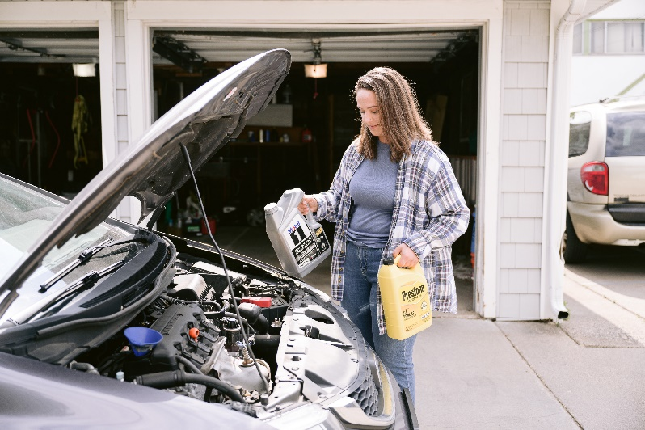
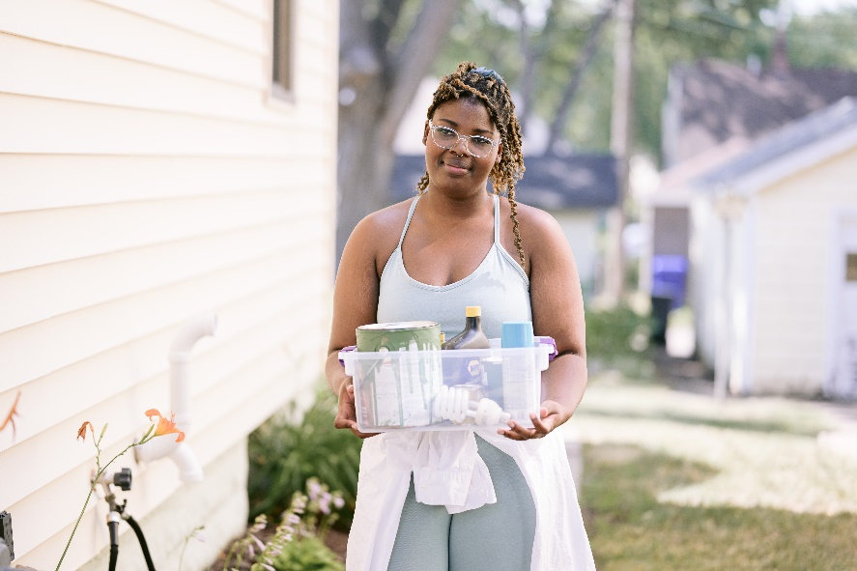
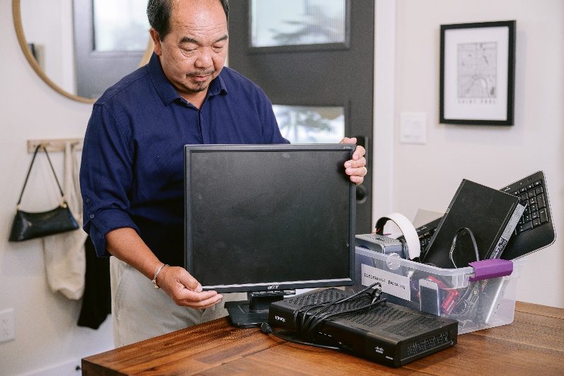
Enhancing Environmental Health Services
System-wide redesign of services provided to residents.
Motivated by resident feedback, which identified opportunities for improvement in accessibility, efficiency and scope of services.
Notes:
Rae
That leads us to our current initiative of Enhancing Environmental Health Services.
Stemming from two strategies in our current solid waste management plan, the county evaluated how it is providing household hazardous waste service to residents. Extensive community engagement and analysis over the past 4 years has lead us to where we are today.
In response, we are developing a new system is to improve accessibility and participation in recycling and waste services for all residents. This system will align with our county goals of well-being and is consistent with a residents first approach.
The redesigned system will:
Better address equity and environmental justice;
Serve more residents;
Help residents manage a wider variety of materials;
Be more cost effective; and
Provide greater access to programs for all residents.
A key element of this redesigned system is a county-owned Environmental Service Center.

Slide 7
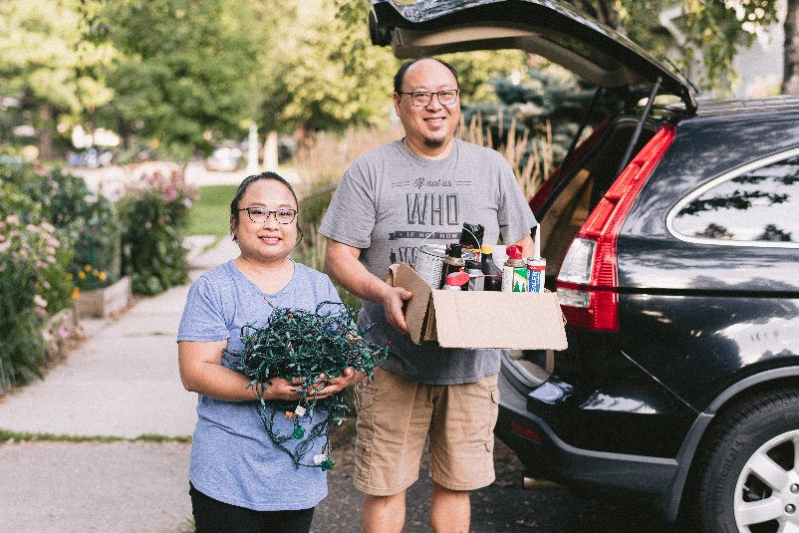
What is an Environmental Service Center?
Facility for the collection of recyclables, food scraps and household hazardous waste.
Household hazardous waste includes items such as cleaning supplies, paint, fuel, batteries, used oil, fluorescent bulbs, electronic waste and more.
Permanent location for Fix-It Clinics.
Free product reuse room where the community can find items like paint, automotive fluids and household cleaners.
Space for community education programs.
Notes:
Rae
Read slide.
The services I just listed will be available to residents for free.
This will replace the services that we currently offer at Bay West on Empire Drive in St. Paul.
This will be a new, county-owned facility to be located at 1700 Kent Street, in Roseville. The facility will be build to B3 2030 sustainability standards – this is similar to LEED certification, but specific to state-funded Minnesota projects.

Slide 8
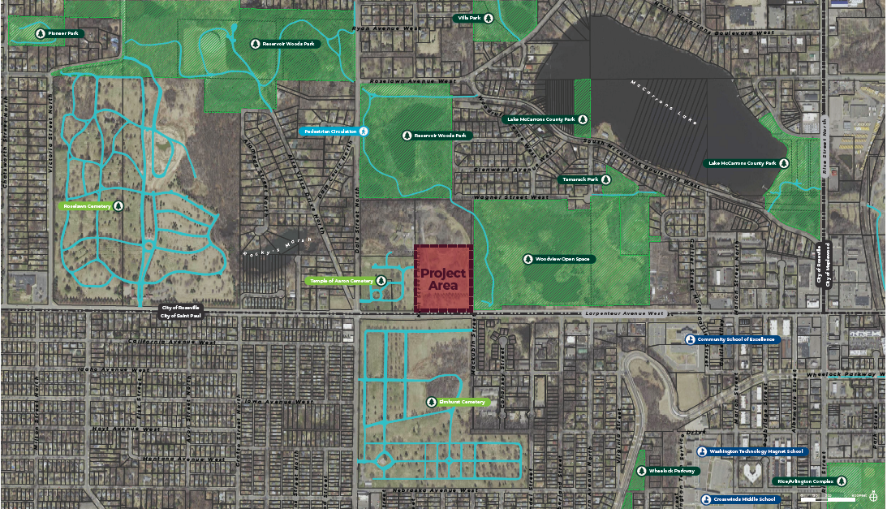
Notes:
Rae
Before we share renderings of what our Environmental Service Center might look like, I want to talk a bit about where it will be located.
After a thorough assessment of accessibility and convenience, as well as cost, environmental impact and space required, Ramsey County, with input from residents, determined that the facility will be located at 1700 Kent Street in Roseville.
We’ve heard from residents that a more welcoming, accessible location with a greater array of services would encourage more people to use our services. We’ve outgrown our current site. The new facility will enable us to offer more services in a more welcoming, accessible location. With the increased use of electronics and batteries, we anticipate that residents will have a growing need for a place to bring these materials, and this new facility will help us meet that need.
Point out Larpenteur and Dale Streets.
Benefits of this site include:
Centrally-located in county
Along public transit routes
County-owned land
No building to tear down

Slide 9
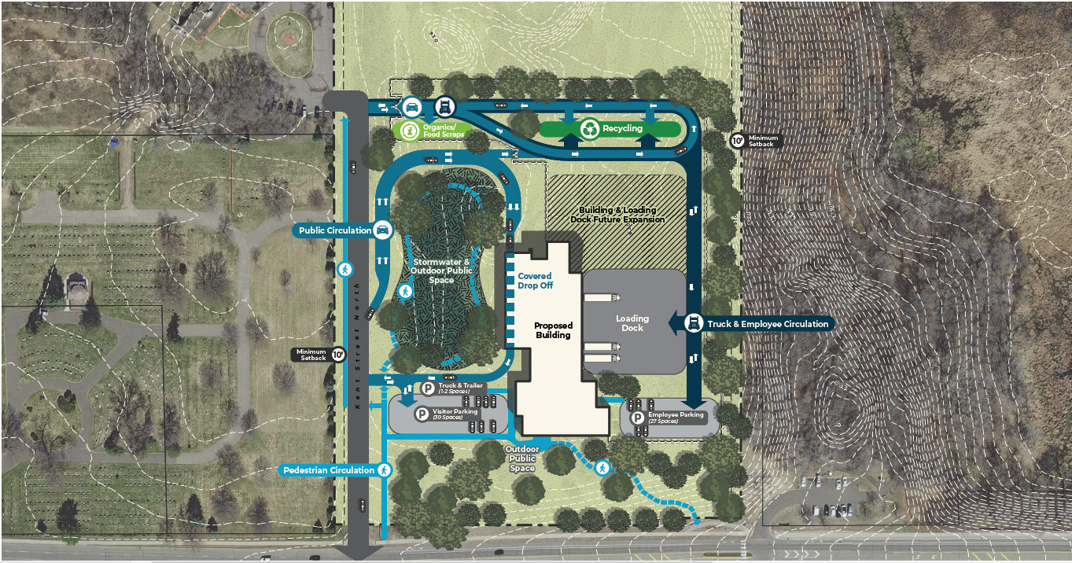
Notes:
Rae
Here you can see the planned site plan.
Call out:
Point out Larpenteur, Dale and Kent Streets
Indicate how residents will access site – flow of traffic to different services
Point out walking path along Larpenteur and connections
Point out vegetation that buffers the site from park and other neighbors
Area to drop off recycling and food scraps (call out cardboard recycling – useful to residents when recycling carts get full)
IN PERSON ONLY: Encourage residents to look at posters and leave feedback there after the presentation
VIRTUAL ONLY: Encourage residents to use survey that will be linked at end of presentation to leave feedback. Feel free to use the chat to share your thoughts at any time.

Slide 10
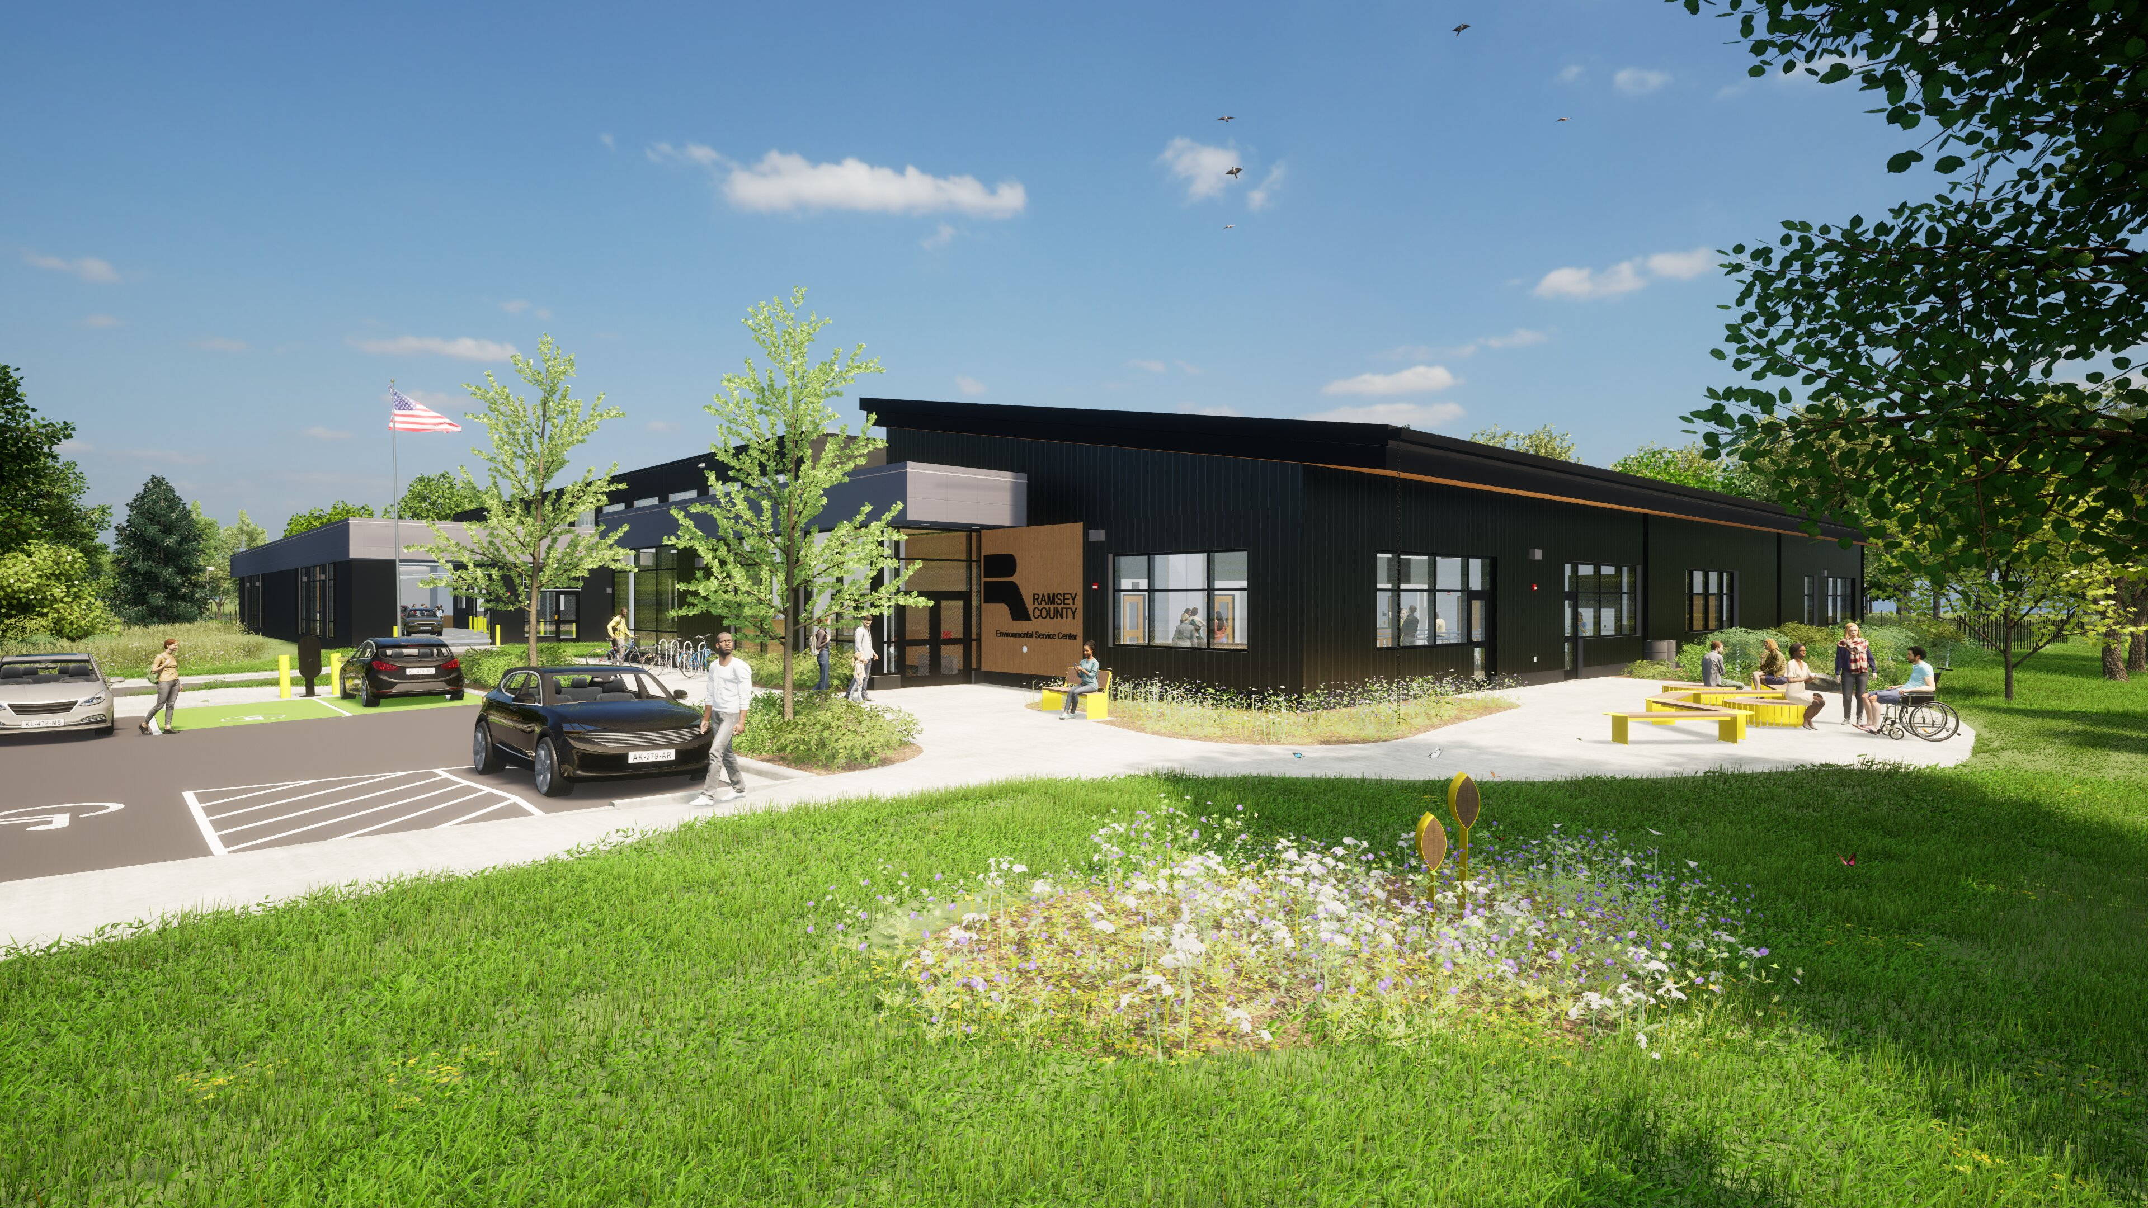
Notes:
Lydia
Here you can see the proposed design for the outdoor space. This shows the front entrance, the public parking lot, and the public gathering area.

Slide 11
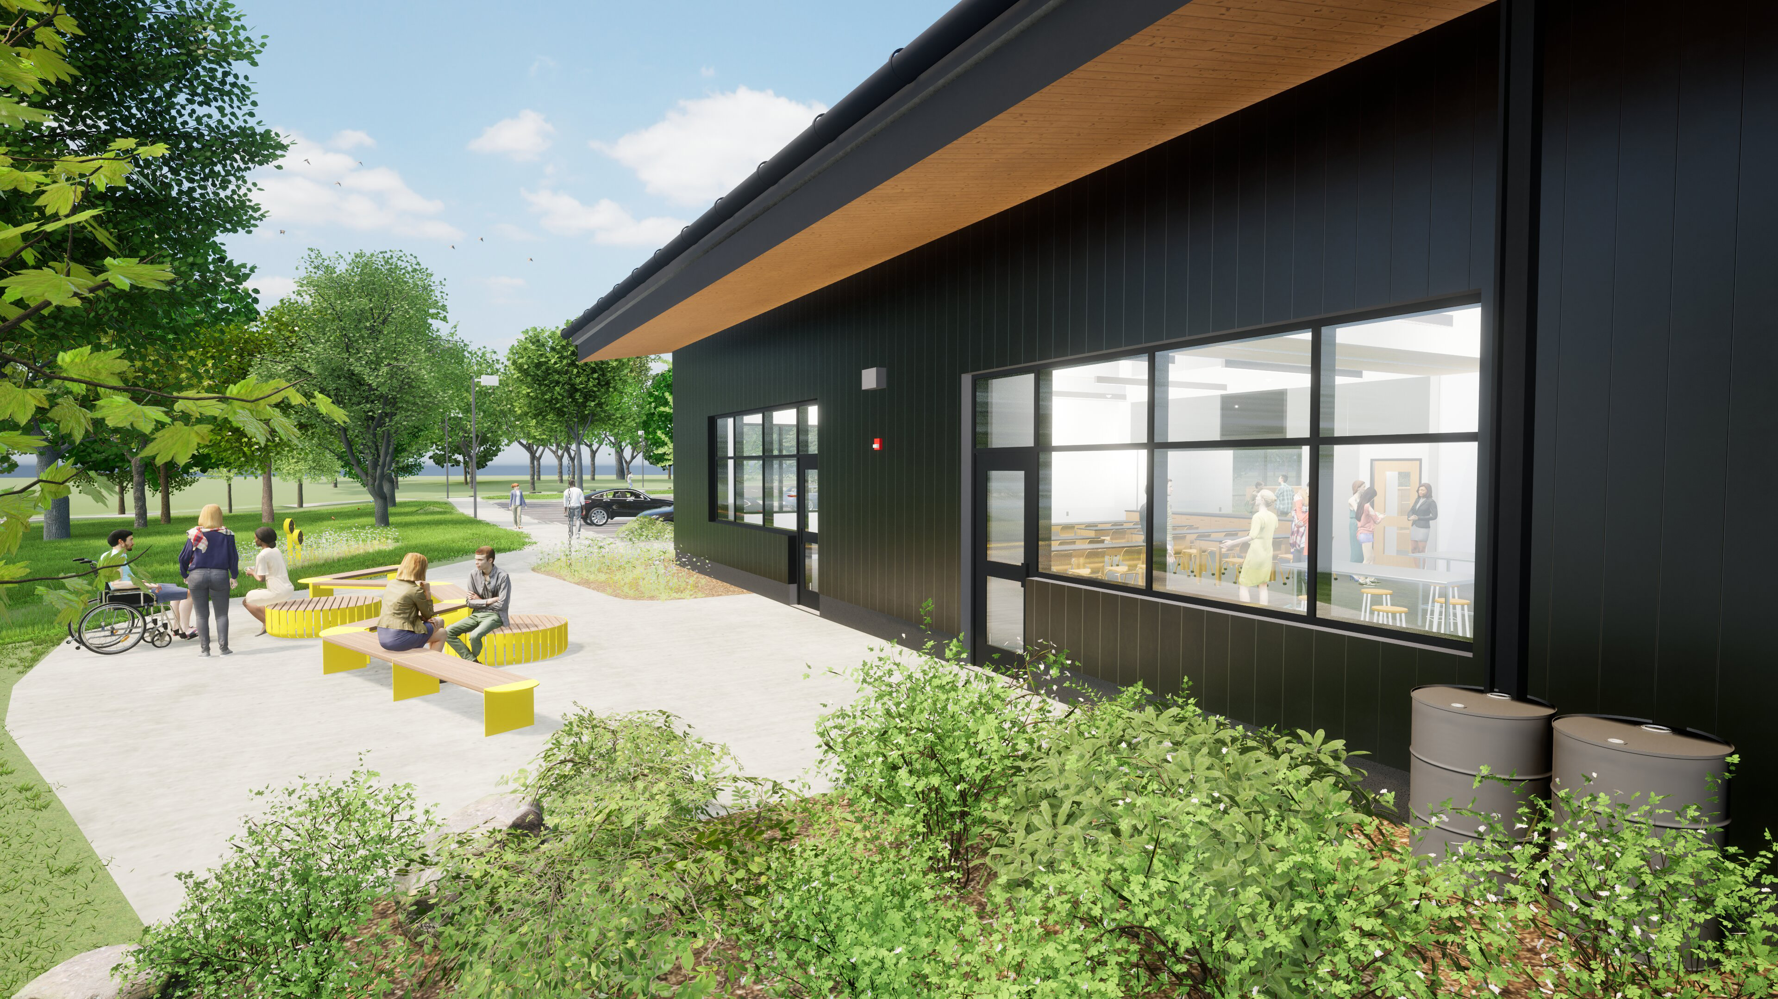
Notes:
Lydia
Here you can see the proposed design for the outdoor programming and educational space. Note rain barrels and native plantings.

Slide 12
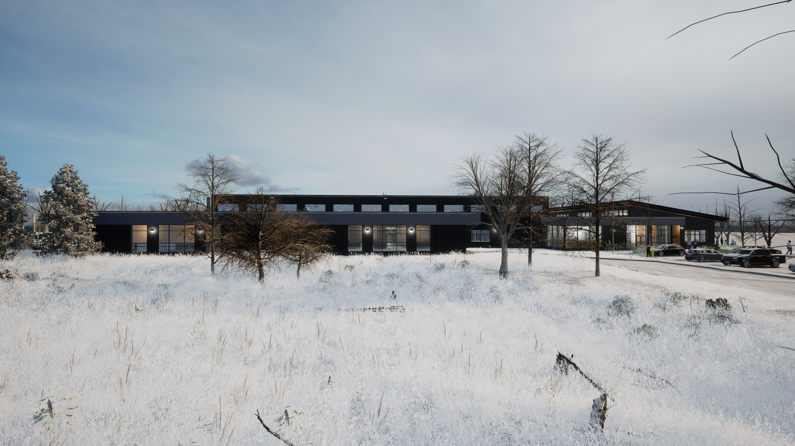
Notes:
Lydia/Martin
And here we see the proposed facility design from the driveway up to the drop-off area.

Slide 13
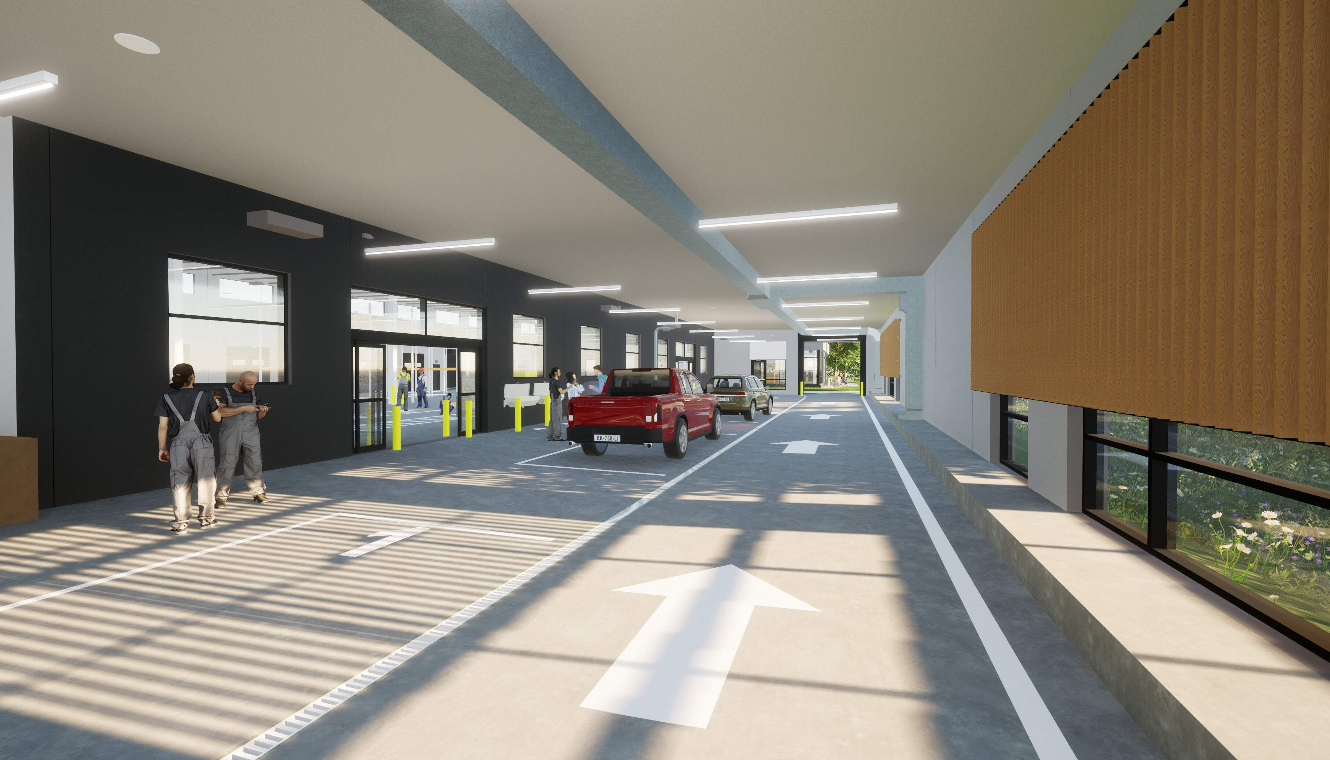
Notes:
Martin
Here is a rendering of the proposed drop-off area. Residents bringing materials to the facility via car will drive up into this area, and staff will unload their materials for them.
The drop-off space will
•Be designed for accessibility and ease
•Offer protection from the weather

Slide 14
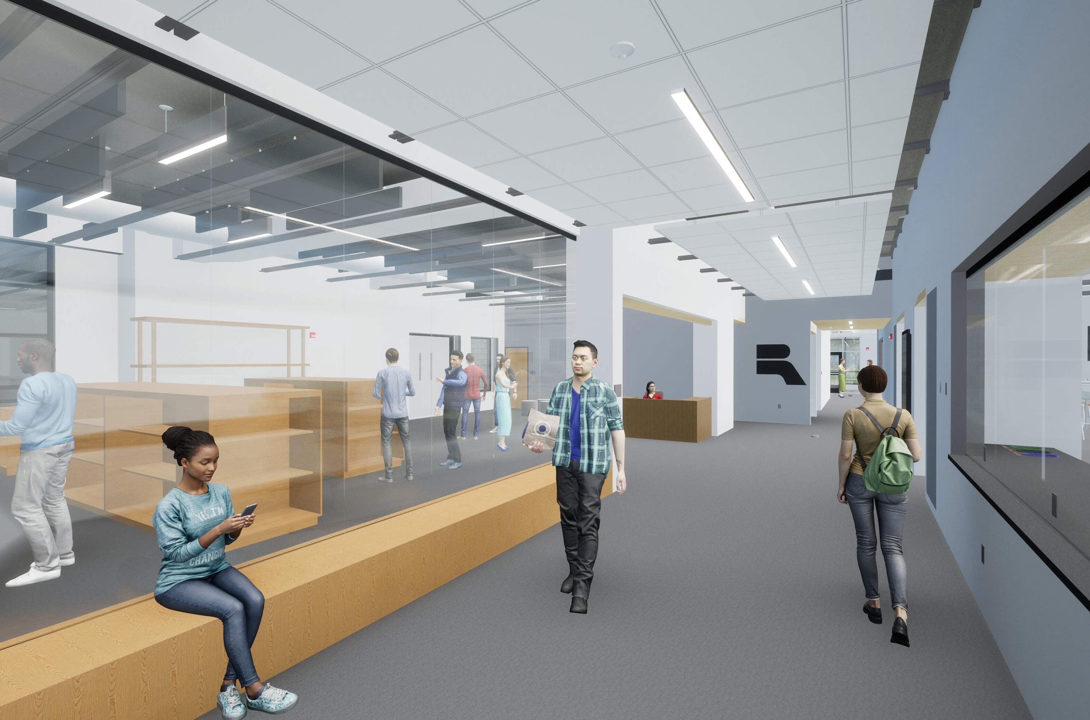
Notes:
Martin
Here you see the proposed design for the lobby and reuse room. In the reuse room on the left, residents will be able to take materials that were dropped off by others but are still in usable condition. This service will be available at no cost for residents.

Slide 15
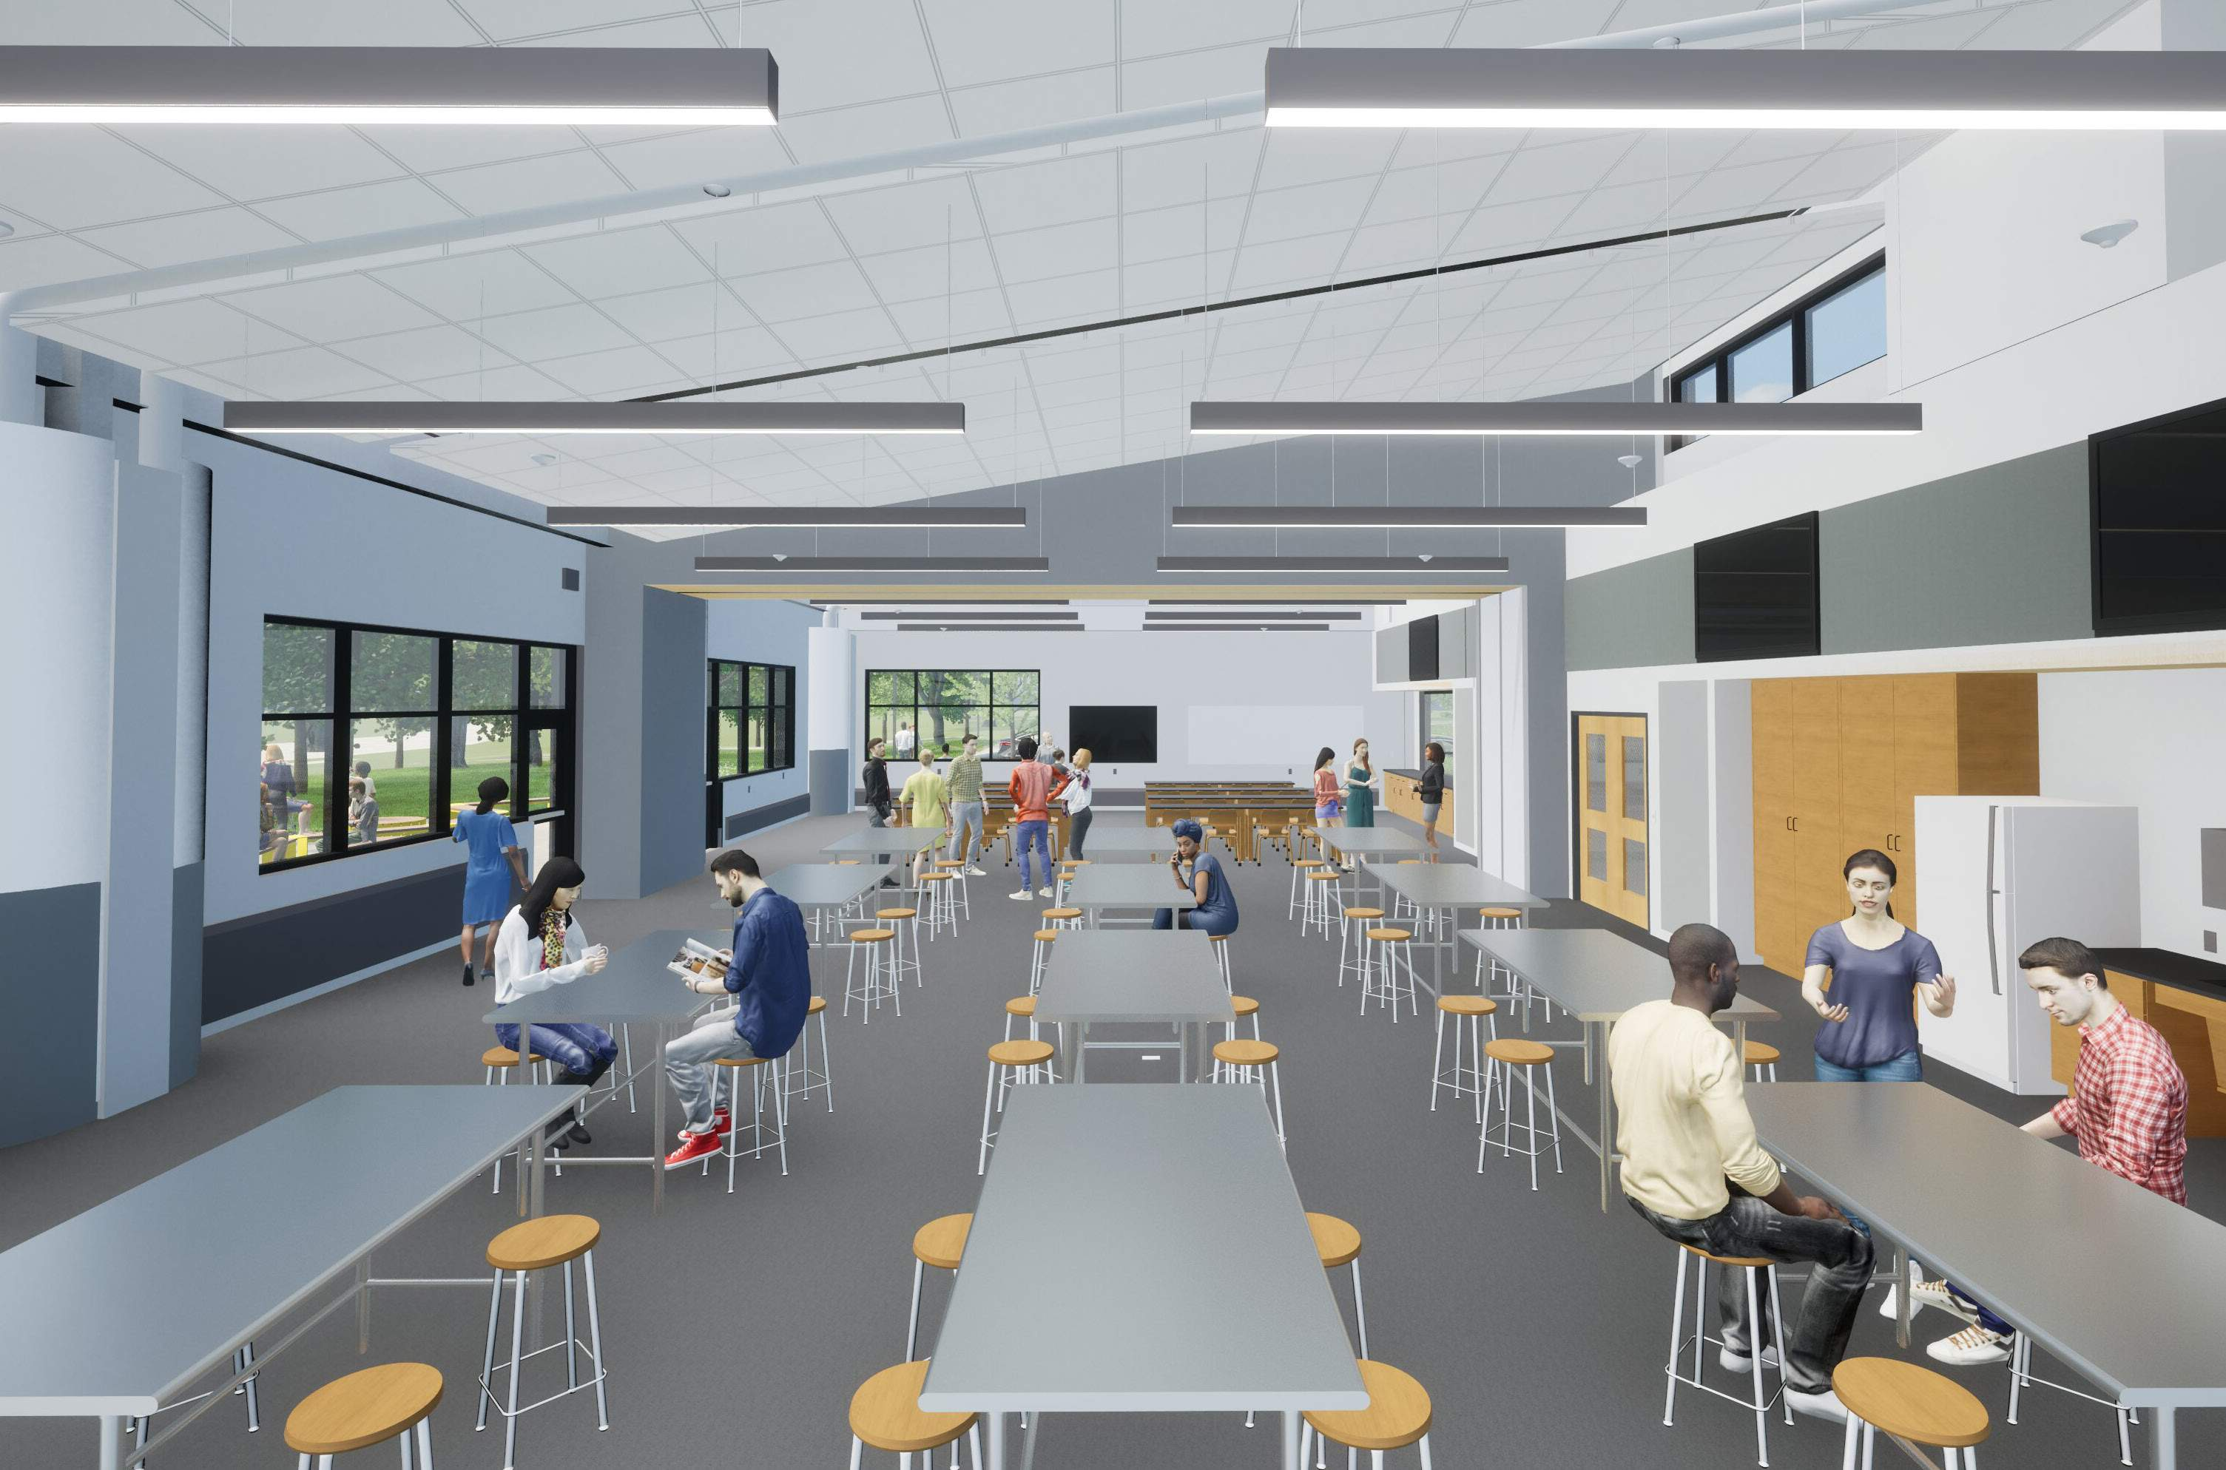
Notes:
Martin
Here you can see the proposed design for the educational community space. This space will host our Fix-It clinics and other educational community programming. It will include a partition so that the room can be separated into two spaces.
Note that this is just an illustration of how this room might be furnished.
IN PERSON: After the presentation, please look at the presentation boards with this content. We’re eager to hear from you what you like and what you think is missing.
VIRTUAL: During our discussion after the presentation, we would like to hear from you what you like and what is missing here. Feel free to use the chat to share your thoughts at any time.

Slide 16
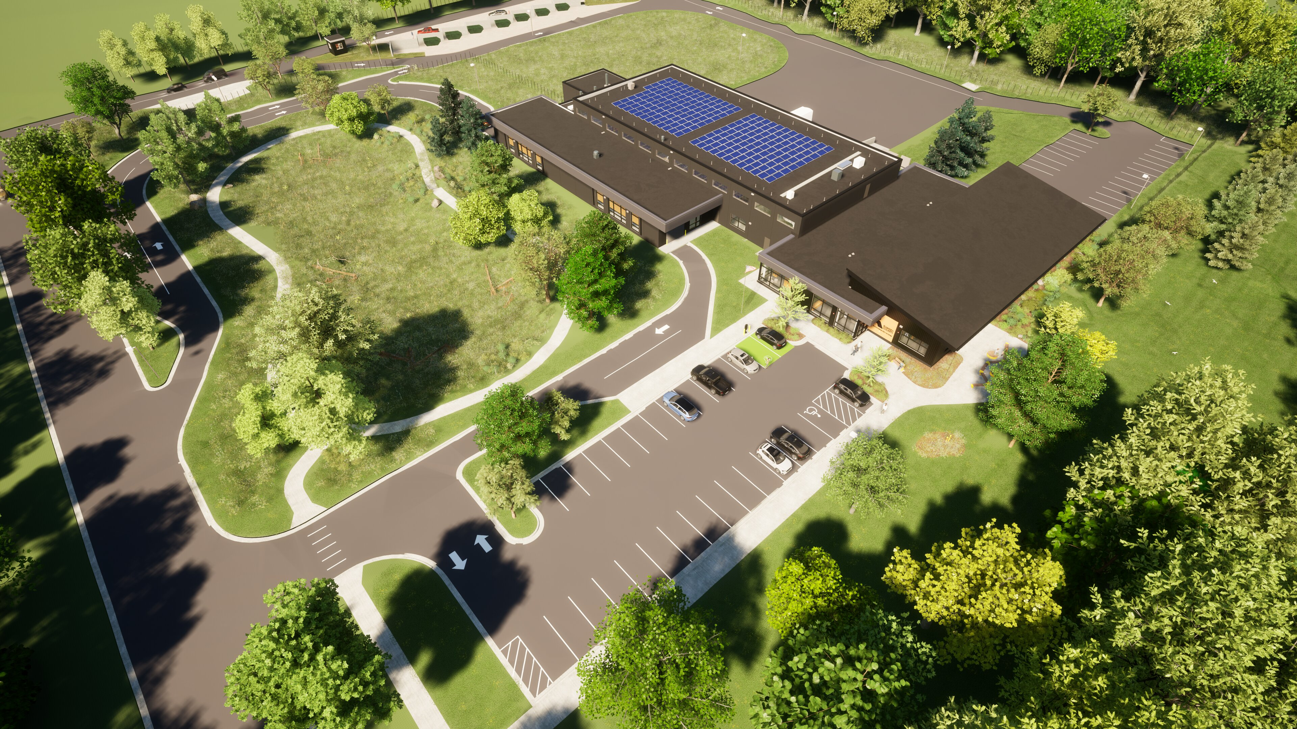
Notes:
Martin
Here is an aerial view of the proposed design of the facility.
Point out:
Drop-off driveway
Sorting/storage area of facility (with solar panels on top)
Food scraps/recycling drop-off
Public parking
Education area
Outdoor education/gathering place
Staff parking and admin area
IN PERSON: After the presentation, please look at the presentation boards with this content. We’re eager to hear from you what you like and what you think is missing.
VIRTUAL: During our discussion after the presentation, we would like to hear from you what you like and what is missing here. Feel free to use the chat to share your thoughts at anytime.

Slide 17
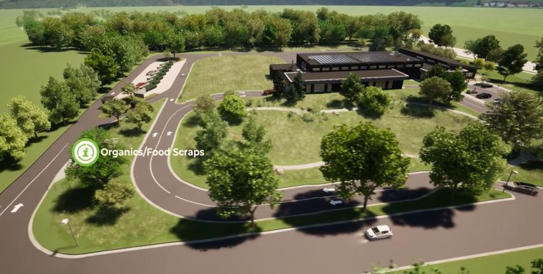
Flyover
Notes:
Martin
Here we'll take a look at a quick flyover of the proposed facility.
Prompt Katie to exit PPT and play video.

Slide 18
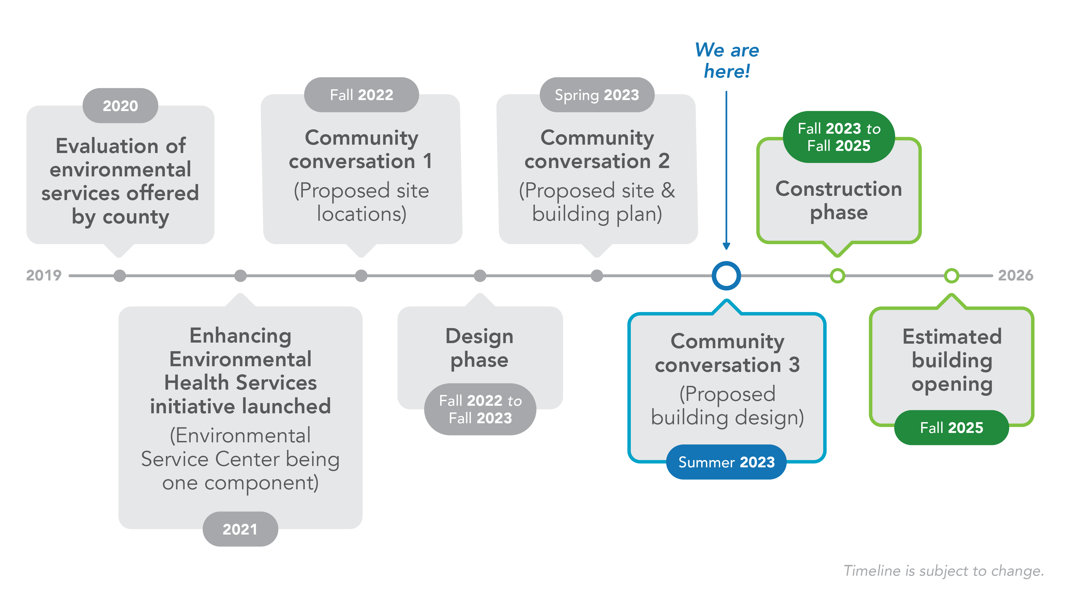
Notes:
Rae
So how did we get here?
In 2020, we conducted an extensive evaluation of our current programs and services. We heard from residents that our services could be more welcoming and accessible. This lead to the Enhancing Environmental Health Services initiative, a key element of which is the construction of the Environmental Service Center.
We've had multiple conversations with community as we've been planning for construction of the Environmental Service Center. Last fall, we shared the proposed location for the facility, this spring we shared proposed building plans, and now we're sharing proposed designs.
On the next couple of slides, I'll share what we've been hearing from you and how we're addressing your concerns.
Read slide
This timeline is tentative and subject to change

Slide 19
What We’ve Heard from You
Through surveys and listening sessions conducted in fall of 2022 and spring of 2023, we heard:
94% of residents are looking forward to using the new Environmental Service Center, while 68% said the new center will encourage them to recycle more.
Residents are excited about:
One-stop shop for recycling and disposal services
Community space
Convenient, accessible location
Residents are concerned about:
Impact to surrounding area – traffic, safety, and noise
Ensuring accessibility
Notes:
Rae
We conducted two rounds of community conversations with residents in the fall 2022 and spring of 2023 – they both consisted of two virtual sessions and two in-person sessions, as well as an online survey. At these sessions, we introduced the project and asked for feedback on the proposed location, proposed site and facility plans and possible services to offer at the facility. Here's what we heard.
Read slide.

Slide 20
Addressing Your Concerns
Impact to surrounding area
New plantings will provide buffer between site and surrounding area
We anticipate the need to remove the non-native, aging evergreens along Larpenteur.
We intend to protect the deciduous trees on the hill down to Larpenteur.
76 to 100 new native and adaptive trees will be planted on the site – we will be planting more trees than we are removing
Hill between site and nature area will help with buffering as well
The county conducted a traffic assessment to ensure minimal disruption to the surrounding area – assessment pointed to an anticipated 3% increase traffic along Larpenteur in the area
Notes:
Rae/Lydia
Here's how we're responding to concerns that have been raised by residents.
For the landscaping topics, hand off to Lydia.
Additional talking points on landscaping:
The building was sited specifically to avoid major impacts to existing healthy trees. Trees that are coming down are either in direct conflict with essential utility work (i.e. underground stormwater management, utility connections to existing infrastructure, etc.) or are already failing/in poor health.
We will also be planting shrubs, perennials, and seed mixes. All will be native plants.
Lydia hand back to Rae to talk about traffic assessment.
IN PERSON ONLY: After the presentation, please view the renderings to get a sense of the proposed landscape plan.

Slide 21
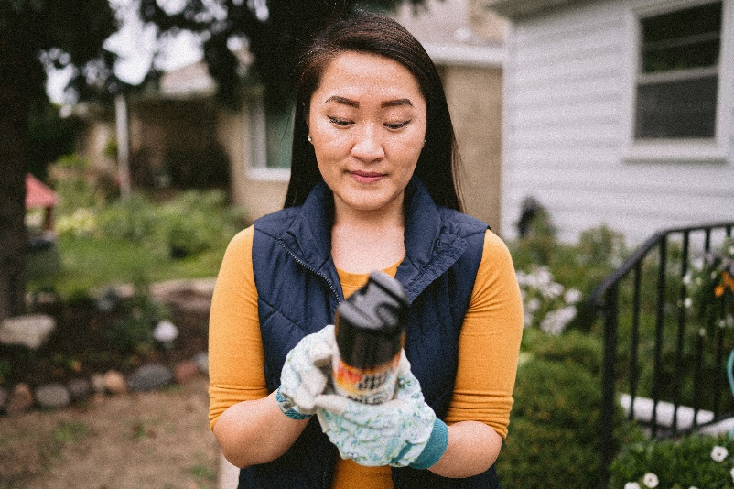
Addressing Your Concerns
Ensuring accessibility
Site is centrally-located in county
Site is located along public transit lines and public walkways
Notes:
Rae
Continuing on with addressing concerns, here is how we're ensuring accessibility- this was important to members of our community.
Plans for future improvements to accessibility include household hazardous waste pickup program for residents without access to transportation.
Read slide.
Additional talking points if needed:
Will have gates to prevent access when facility is closed.
Site will have lighting on the site for safety, but it will be designed not to cast light off the site.
If asked, can say that facility is constructed to minimize spills and to capture liquids should a spill occur. No hazardous materials will be stored outside.
If asked, can say that odor is not an anticipated issue. The food scraps that will be collected at the site will be the most odor-causing materials collected, and odor has not been an issue at other food scrap collection sites.

Slide 22
Funding Source
The Solid Waste Fund, generated from the Ramsey County Environmental Charge, will be used to build the Environmental Service Center.
The County Environmental Charge is a fee on trash collection services – it's part of your trash bill
Projected cost range: $27 - $29 million
There will be no increase to the existing County Environmental Charge as a result of constructing this facility.
Notes:
Sara
Read slide
The County Environmental Charge (CEC) is a fee on trash collection services. The funds generated from this must be spent on solid waste activities and strategies.
There will be no increase in costs to residents or businesses due to this project.

Slide 23
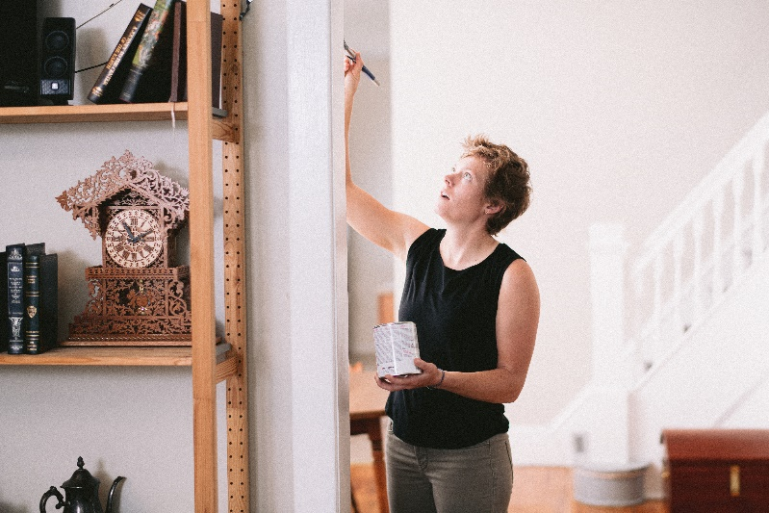
Next Steps
Resident survey: www.ramseycounty.us/ESC
Feedback gathered through these conversations and the survey will inform final facility design.
Sign up to receive project updates at link listed above.
Anticipated groundbreaking in late 2023 or early 2024.
Notes:
Sara
We have a survey open, which you can access using the link on the screen. Please share thoughts there if you are not able to do so today.
On Tuesday, Aug. 8, 12:00 – 1 pm, we'll be hosting a virtual community conversation. You can find the Zoom link on the webpage on the screen.
Feedback gathered through this process will inform final facility design.
We hope to break ground this fall or next spring.

Slide 24
Questions?
www.ramseycounty.us/ESC
AskEH@ramseycounty.us
Notes:
Sara
Thank you for your time. We'd like to open the floor to questions. We'll do the gift card drawing following your questions.
For more information, please visit our webpage www.ramseycounty.us/ESC. There, you'll find the survey, FAQ, a spot to sign up for email updates on this project, and a form to use to contact us with questions.
IN PERSON ONLY: Please take time to walk around to the various poster board. Staff will be standing next to the display to answers any questions you may have tonight.
VIRTUAL: Please take the survey that you can find on the website above if you aren't able to share all your thoughts tonight.

Slide 25
Gift card drawing!
Notes:
Sara/Nawal
Let's see who the two lucky folks are that get to walk away with a $50 visa gift card. We offer incentives like this as a way of compensating residents for their time and ideas by participating in conversations like this. Your feedback helps us better serve our residents!
IN PERSON: Pick a number from jar and call out number: Audience member with corresponding number will need to go back to welcome desk to claim prize. Repeat for second winner.
VIRTUAL: You should all see a poll on your screen asking for your name and address, please complete and submit to enter the drawing. Once we've received all responses we'll run everyone's name through a name randomizer and select a winner. We can take a couple questions while we're getting all of that set up. Jordan please let us know when you're ready.

