Slide 1
MFIP Extension Services Training
Employment Services Staff
June 2021

Slide 2
  What is EXS
  EXS Eligibility Criteria
  Documentation Required
  EXS Requests
  EXS Process
  Special Circumstances
  Tools
  DS Best Practice
  Resources
Agenda

Slide 3
What is Extension Services (EXS)
EXS is a post 60-month service track within MFIP to serve families with complex needs
  Qualified participants can have their MFIP eligibility extended after 60 months of assistance if they meet the criteria for at least one extension category.
  EXS eligibility criteria is similar to FSS.
  Help families achieve the greatest degree of economic self-sufficiency and family well-being.

Slide 4
Working with EXS Families
Qualified professional determine hours
Average EXS time frame range (3-12months)
Utilize professional network to establish resources
Continuous Engagement and Support

Slide 5
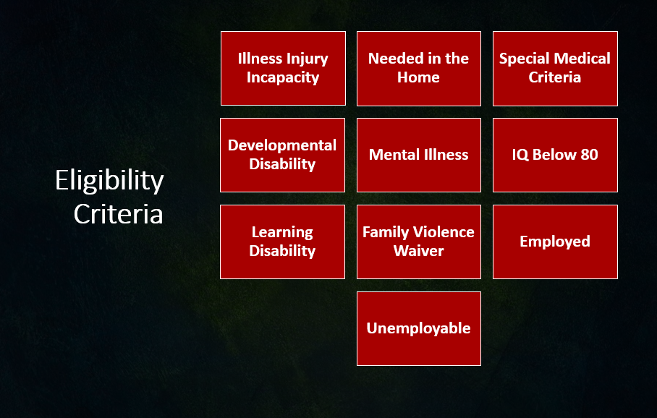
Notes:
Extension categories and documentation requirements are the same as FSS except for four categories:
In the country for less then 1 year is not an Extension category.
Appling for SSI is not an Extension Category.
Age 60 or Older is not an Extension Category.
Extension is awarded to employed participants working at least 30 hours/week

Slide 6
EXS Eligibility Criteria
Hard to Employ
Ill/Incap
Ill/Incap – Special Medical
Unemployable, IQ<80, learning disability, mental retardation and mental illness.
Participant ill/incap for over 30 days, participant needed in the home to care for an ill/incap family member or family violence.
Participant found eligible for PCA Services, waivered services or having a SPMI diagnosis. This category is also for participants who have a child who is diagnosed with a severe emotional disturbance (SED).

Slide 7
EXS Eligibility Criteria
Employed
Other
Employed extensions are for single parent households employed 25+ hours/week or found eligible under employed/Reduced hours. Two parent households must be employed 55+ hours/week to meet extension criteria.
This category is for extensions approved due to appeal.
This category is also used for extension denials due to no extension identified or if the client has not provided documentation to verify extension eligibility.

Slide 8
Supporting Documentation for EXS
Request for Medical Information Cover Letter
  Medical Opinion Form: Participant Medical
  Opinion Form – Serious and Persistent Mental Illness (SPMI)
  Medical Opinion Form – Family Member needing Care
  Medical Opinion Form – Severe Emotional Disturbance (SED)
Authorization for Release of Employment Information
Notes:
- These documents are found on the WFS Provider Page.
FVW – required documentation is the same as pre-60 participants
Phycological evaluations
IEP (for SED child)
Qualified Professional

Slide 9
Other Types of Supporting Documentation
  Domestic Violence Documentation
  IEP (SED Child)
  Doctor’s Note
  Psychological Evaluations
Documentation must be completed by a qualified professional as defined by the Employment Service Manual - 17.45 Qualified Professionals.

Slide 10
EXS Requests
There are three different types of extension requests.
1. Initial Extension
Application for participants who wish to transition from pre to post 60 MFIP
2. Redetermination
Extended participants applying for extension renewals
3. Post 60 Reapplication (P60R)
Occurs when an exited participant applies for MFIP after exhausting 60 MFIP months. ES must confirm EXS eligibility within 30 days for FAS to award MFIP benefits.
Notes:
P60R – Referred to ES by FAS BEFORE MFIP approval. Engagement of P60R cases is top priority. Extension eligibility must be met before MFIP can be approved. Designated Staff is to send notification via mail informing that eligibility needs to be established. WFS usually includes a MOF in the notice in case it is needed.
Designated Staff should also contact the participant via phone to inform of eligibility requirements/needs.

Slide 11
Extension Packet Requirement:
Face to Face Checklist (applies to Initial Extension only)
Extension Decision Form (with top half completed)
All Unexpired documents supporting the extension category requested by the participant.
Any documents showing non-compliance, such as NOITS or Status Updates within the previous 12 months.

Slide 12
EXS Process
WFS MIS creates and distributes the Data Specialist Report (spreadsheet) weekly to agency Data Specialists to track eligible Extension Cases.
Agency Data Specialists are responsible to distribute lists to Counselors to ensure services and proper documentations are obtained in a timely manner.

Slide 13
EXS Process
ES is responsible for informing participants about EXS and assisting participants in gathering required eligibility documentation needed to apply.
Provide documentation that will be used to determine EXS eligibility to participant (MOF, EVF, etc.). Allow 30 days for participant to receive and return documentation and another 30 days for ES/FAS processing.
Complete EXS Decision Form and attach completed supporting documentation, submit to Manager/Supervisor for review and approval.

Slide 14
EXS Process
Submit Status Update form to FAS to communicate approved or denied EXS request. If approved, include EXS category, start and end date. See FAS Coding Tips.
  Note: Include all categories that qualify a participant for EXS. MAXIS follows a hierarchy to determine which EXS code will be used
    Preferred: FAX : 651-266-3930
  Option 2: fas.forms@co.ramsey.mn.us
WFS Only: Index Extension Decision form into Laserfiche. No Status Update required.
Notes:
Vendor Agencies: Fax WF1 Status Update to FAS to notify of extension decision. Do not include supporting documentation with SU. Index supporting documentation and EXS decision form into WF1 EDS.

Slide 15
FSS Process
EXS Process
Store all documentations in WF1 EDS or Laserfiche.
If EXS Denied, hold for pending MFIP closure and close EXS Local Flag activity. Case note EXS decision. If EXS approved, continue. See case note expectations in Extension Process.
Update WF1 Local Flag using MIS approved subtype. Include start and end date. Case note EXS decision. Refer to MIS Subtype.
Identify services, supports, education, training, and accommodations needed and enable meeting personal and family obligations.

Slide 16
EXS Process
Develop EP with participant, using supporting EXS documentation, include activities and hours of participation as appropriate. (reduce barriers, stabilize family and securing employment)
Monthly follow-up and case notes and assist families in accessing the identified services and supports when necessary.
Case note minimum necessary information: Rarely include an actual diagnosis
Ex: “Medical condition present” or “medical condition restricts activities. See file”

Slide 17
EXS Process
10. Monitor progress, track participation hours
Help the participant in any way that makes sense to document activities. Ex: Monthly Activity Log, Phone call, Email, Case note by counselor
Monthly activity log is required - If participant is receiving Chemical dependency treatment, Mental health treatment, Rehabilitation services.

Slide 18
EXS Process
Review the EP (minimum every 6 months) and modify the plan as appropriate, or as often as needed. Case note.
Request new/updated documentation to support continued EXS two months before EXS end date. Case note.
(Process resumes at step 2)
Provide ongoing resources and support

Slide 19
Special Circumstances
Special Circumstances
2 Parent Families
EXS is individualized, only the parent who reaches 60 months applies for EXS. A parent who is pre 60 does not apply for EXS until month 59.
The 60-month parent has the option of applying for EXS or to be removed from the MFIP grant.
Direct participants who want to remove a parent from the MFIP grant to FAS.

Slide 20
Special Circumstances
Banked Months
Participants eligible for special medical criteria receive “banked months”: Each month a participant is eligible for Special Medical Criteria before reaching the 60-month limit is “banked”.
MAXIS uses these banked months once a participant has reached 60 months.
Only after the banked months are expended is the participant assessed for an extension.

Slide 21
Special Circumstances
Sanctions
Participants sanctioned in the 60th MFIP month are not eligible for EXS.
Participants sanctioned more than 2 months between months 48 and 60 are not eligible for employed extensions.
All post 60 sanctions mirror the FSS Sanction process except for employed extensions (ESM 18.18.3 Employed).

Slide 22
Special Circumstances
Appealed EXS Decisions
Vendor Agency/Counselor/Designated staff will be responsible for gathering supporting documentation required for appeals.
EXS is approved under “other” category during the appeal process.

Slide 23
Next Steps
The WFS Extension Review Team (ERT) will continue processing Extension Decisions until September 1, 2021.
Starting September 1, 2021, agency Managers/Supervisors will be responsible for processing agency EXS decisions.
Each agency will be responsible for creating their own internal process to track and monitor extension decisions.
WFS will provide ongoing support through scheduled monthly consult. Additional consultation will be made available as needed.
If additional assistance is needed, please contact your agency planner.

Slide 24
EXS SUMMARY
Inform/ Assess potential EXS
Manager/ Supervisor Decision
EXS Approved submit Status Update 651-266-3930
Or Laserfiche
EXS Document and EXS Decision Form
EXS Denied/ MFIP Closure
Submit Status Update 651-266-3930
Or Laserfiche

Slide 25
TOOLS
1. DS Data Spreadsheet
Initial Extension – Active Participants Tab
Redetermination – Extension Review Tab
Overdue Extensions – Extension Review Tab
EMPS/EXS Mismatch – Employment Plan Tab
2. Reports in WF1
Employment Plan report
Please direct DS questions to:
Alan Wanless (651) 266-6010
Breanne Hanscom (651) 266-9865

Slide 26
DS Best Practice
Monthly Reports to assist with EXS Process
It is recommended that the following reports are distributed on or near the first of every month.
Pre-Extension Report
Flag 48+ month cases to assist counselors in identifying pre EXS communication and document needs.
Extension Due Report
Identifies cases that require EXS redetermination. This report highlights cases that have EXS end dates two months before redetermination is due. (July report will showcase redetermination's due in September).
Extension Clean Up Report
Highlights cases with overdue extensions. These cases require review and follow-up action.

Slide 27
RESOURCES
EXS Categories and Plan Types
Maxis Coding Hierarchy
Qualified Professionals Definition
EXS Process
FAS Coding Tips for Employment Services
WF1 Outgoing Status Update User Guide
DHS MFIP Manual : Time Limits and Extensions
RC Provider Webpage
WF1 Valid Codes for Activity Sub Type

Slide 28
THANK YOU!
Questions?
Contact Your Assigned Agency Planner

