Slide 1
Family Stabilization Services (FSS)
June 2021

Slide 2
  What is FSS
  FSS Eligibility Criteria
  Documentations Required
  FSS Process
  Tools
  Resources
Agenda

Slide 3
What is Family Stabilization Services (FSS)
FSS is a service track within MFIP to serve families with complex needs
  Provide more flexibility in services and program expectations in order to help families address health and personal challenges.
  Help families achieve the greatest degree of economic self-sufficiency and family well-being.
  FSS count toward the 60-month time limit except: Family Violence Waiver, Age 60 years old or older.

Slide 4
Working with FSS Families
Qualified professional determine hours
Average FSS time frame range (3-12months)
Utilize professional network to establish resources
Continuous Engagement and Support

Slide 5
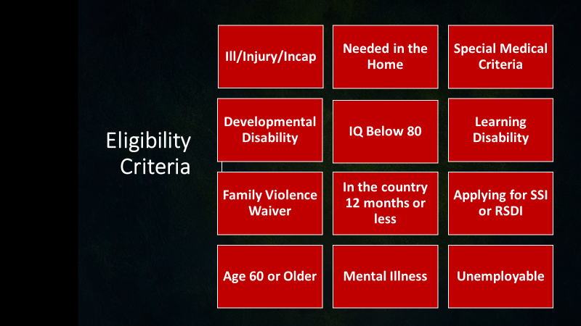

Slide 6
Common Documentation for FSS
1. Request for Medical Information Cover Letter
  Medical Opinion Form: Participant
  Medical Opinion Form – Serious and Persistent Mental Illness (SPMI)
  Medical Opinion Form – Family Member needing Care
  Medical Opinion Form – Severe Emotional Disturbance (SED)
Notes:
- These documents are found on the WFS Provider Page.
FVW – required documentation is the same as pre-60 participants
Phycological evaluations
IEP (for SED child)
Qualified Professional

Slide 7
Less Common Documentations
  Medical Opinion Form: Temporarily Unemployable Participant
  IEP (SED Child)
  Doctor’s Note
  Psychological Evaluations
  DV Documentation

Slide 8
FSS Process
FAS and ES have a shared responsibility in identifying potential FSS. Explain potential FSS eligibility to participant.
Provide Medical Opinion Form to participant. Allow 10 working days to receive form.
Complete FSS Screening Form and attach completed Medical Opinion Form, submit to Manager/Supervisor for review and approval.

Slide 9
FSS Process
Submit Status Update form to FAS to update FSS category, include start and end date. See FAS Coding Tips.
  Note: include all categories that qualify a participant for FSS. MAXIS follows a hierarchy to determine which FSS code will be used
    Preferred: FAX : 651-266-3930
  Option 2: fas.forms@co.ramsey.mn.us
Store all documentations in WF1 EDS or Laserfiche.

Slide 10
FSS Process
FSS Process
Complete an assessment of strengths, barriers, and special circumstances may impact progress toward goals (ex: MBS/EM)
Identify services, supports, education, training, and accommodations needed and enable meeting personal and family obligations.
Develop EP with participant, using medical opinion, include activities and hours of participation as appropriate. (reduce barriers, stabilize family and securing employment)

Slide 11
FSS Process
Monthly follow-up and case notes and assist families in accessing the identified services and supports when necessary.
Case note minimum necessary information: rarely include an actual diagnosis Ex: “Medical condition present or medical condition restricts activities. See file”
10. Monitor progress, track participation hours

Slide 12
FSS Process
Help the participant in any way that makes sense to document activities. Ex: Monthly Activity Log, Phone call, Email, Case note by counselor
Monthly activity log is required - If participant is receiving Chemical dependency treatment, Mental health treatment, Rehabilitation services.

Slide 13
FSS Process
Review of the EP (at least every 6 months) and modify the plan as appropriate, or as often as needed
Request a new medical opinion form each year to assess the participant’s ability to work and create a new plan every 12 months even if there are no changes.
Provide ongoing resources and support

Slide 14
FSS SUMMARY
Inform/ Assess potential FSS
Manager/ Supervisor Decision
FSS Approved submit Status Update 651-266-3930
FSS Document and FSS Checklist
EP - monitor progress
Support/ Resources –

Slide 15
TOOLS
  1. DS Data Spreadsheet
  Employment Plan tab
  2. Reports in WF1
  Employment Plan report
  FSS Coding Expiration Detail
  FSS mismatch Detail in WF1

Slide 16
RESOURCES
FSS Categories and Plan Types
Maxis Coding Hierarchy
Qualified Professionals Definition
FSS Process
FAS Coding Tips for Employment Services
WF1 Outgoing Status Update User Guide
DHS MFIP Manual : FSS Section
RC Provider Webpage

Slide 17
THANK YOU!
Questions?
Contact Your Assigned Agency Planner

