Slide 1
Self-Support Index
Ben Jaques-Leslie

Slide 2
Overview
Performance measures
What is the Self-Support Index
Score
Range
Scores for your agency
Why we use the Self-Support Index?
Concerns about the Self-Support Index
Self-Support Index Data tool
Notes:
We are here to speak to you about how we measure economic mobility in Minnesota’s TANF. I’ll start be describing the measure: The Self-Support Index. I’ll explain why the state decided to develop this measure and how we use the results. We’ll talk about what we see as some of the strengths of the measure, some challenges that we face, and how we go about continually improving the measure. Lastly, we’ll share some thoughts and advice about using an outcome measure of this type of TANF.

Slide 3
Performance measures
Quantifies how program is working
What we’re doing (process)
How well we’re doing it (outcome)
Ideally…
Good process measures → Good outcomes

Slide 4
Performance Measures in MFIP
How the S-SI and WPR differ | How the S-SI and WPR differ
Self-Support Index | Work Participation Rate
Outcome measure | Process measure
Mandated by Minnesota Legislature | Federally mandated
All MFIP caregivers | TANF (work eligible individuals)
Over three years | Point in time (month)
Off MFIP or working 30 hours per week | 87 or 130 official activity hours per month

Slide 5
Self-Support Index
Two part of the Self-Support Index
Score
Range

Slide 6
Self-Support Index
Two part of the Self-Support Index
Score
Range

Slide 7
Self-Support Index Score
All eligible adults on MFIP/DWP in a quarter
Three years later are they successful
No longer receiving cash assistance
Receiving cash, but working at least 30 hours per week
Notes:
The Self-Support Index is a individual outcome measure, aggregated to local agencies. We look at all adults on TANF in Minnesota in a quarter three years ago and determine if they are successful three years later. A participant is considered successful if they are no longer receiving cash assistance or if they are, they are working at least thirty hours per week. Operationally, this means that if we are calculating the Self-Support Index for the fourth quarter 2019, we take all the adult TANF participants in the fourth quarter 2016 and look at their TANF participation in Q4 2019.

Slide 8
Self-Support Index Score
Percent of adults in a quarter that are Self-Support Index successful three years later
Each local agency gets a score
Local agencies include: Counties, Tribal agencies, and County consortia
Notes:
Once we have individual’s Self-Support Index results, we aggregate to the local agency. The local agency score is very simply the percent of the local agency’s TANF adults who were successful in that quarter. Minnesota is a state-supervised county-administered program. Some counties form consortia to implement human service programs and Tribal agencies operate programs as well. The Self-Support Index is aggregated to counties, tribal agencies, and county consortia.

Slide 9
Self-Support Index Score
$$S−SI=\frac{SuccessfulAdultsNow}{AllAdultsThreeYearsAgo}$$

Slide 10
Self-Support Index Example
In Q2 2018, Wiget County has 678 adults on MFIP or DWP.
In Q2 2021, of those 678 adults:
505 are not receiving cash assistance
15 are receiving cash assistance, but work 30 hours per week
158 are receiving cash assistance from MFIP or DWP
Let’s calculate the Self-Support Index score!

Slide 11
Self-Support Index Example
$$S−SI_{Wiget}=\frac{\left(505NoCash+15Hours\right)}{678Adults}$$
$$S−SI_{Wiget}=\frac{520SuccessfulAdults}{678Adults}$$
$$S−SI_{Wiget}≈76.7\%$$
Notes:
WOE is calculated in this way. It is 10 times the log of the probability that the evidence is true given the first hypothesis over the probability that the evidence is true is the alternative hypothesis is true.

Slide 12
Self-Support Index: Bad Outcomes
An adult no longer receiving cash assistance is not considered successful, if they leave due to:
Time limits
Sanctions
They can become successful, though

Slide 13
Self-Support Index Sources
All data for the index comes from MAXIS | All data for the index comes from MAXIS
Data | Source
Hours | STAT/JOBS, BUSI, RBIC
Supplemental Security Income | STAT/UNEA
Relationships | STAT/MEMB, STAT/PARE
Sanctions | STAT/SANC
Countable Months | STAT/TIME

Slide 14
Self-Support Index
Two part of the Self-Support Index
Score
Range

Slide 15
Self-Support Index
Two part of the Self-Support Index
Score
Range

Slide 16
Self-Support Index Range
Each local agency has a customized range of Self-Support Index scores that they should fall within
Range is generated by predicting the likelihood of an adult’s Self-Support Index based on factors outside of the control of the local agency:
Demographics of person and household
Local economic and community factors
Notes:
A key innovation of the Self-Support Index is the benchmark against which local agency scores are measured. Rather than a subjective minimum value of expected success, each agency has a customized range of expected Self-Support Index Scores. The range is created by predicting the likelihood that an individual based on factors that are outside of the control of the local agency. We use demographic factors about the participant and their household as well as information about the local economy and community. Technically, we are generating predictions using bootstrapped logistic regressions. The next couple of slides will give you a sense of what the results look like for agencies.

Slide 17
Self-Support Index Factors
Participant Information | Participant Information | Participant Information
Source | Model | Data
MAXIS | New | Average spell length, Counted months, Started with year, Youngest child aging out
MAXIS | Continued | Age of adult at baseline, Age of adult at birth of first child, Age of youngest child at baseline, Assistance from another state, Ever married, Gender, High school diploma or GED, Housing subsidy, Immigrant, Inter-county moves, Interpreter needed, Number of children in family, Race and ethnicity, SSI adult in family, SSI child in family, Student, Two-parent case
Other | Continued | Average child support, Chemical dependence diagnosis, Mental health diagnosis

Slide 18
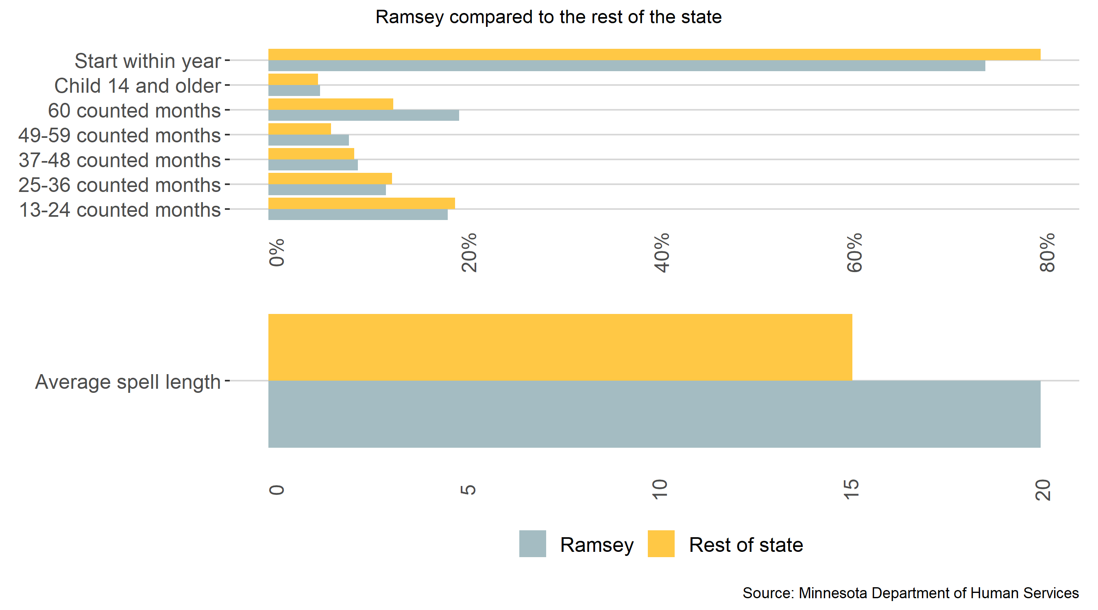
Self-Support Index Factors

Slide 19
Self-Support Index Factors
County Information | County Information
Data | Source
County unemployment rate | MN Department of Employment and Economic Development, US Department of Labor
County child poverty rate | US Census
Population density | US Department of Agriculture
Child Care Availability | MN Department of Human Services

Slide 20
Self-Support Index Factors
How do factors affect the range?

Slide 21
Self-Support Index
Questions?

Slide 22
Self-Support Index
QUIZ

Slide 23
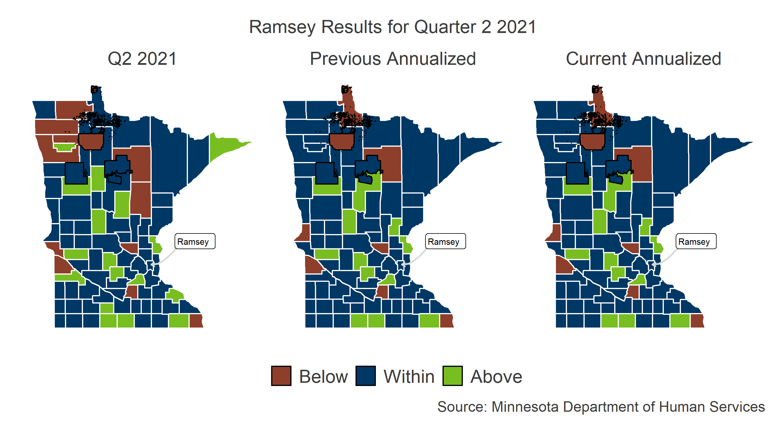
Self-Support Index Results: Ramsey

Slide 24
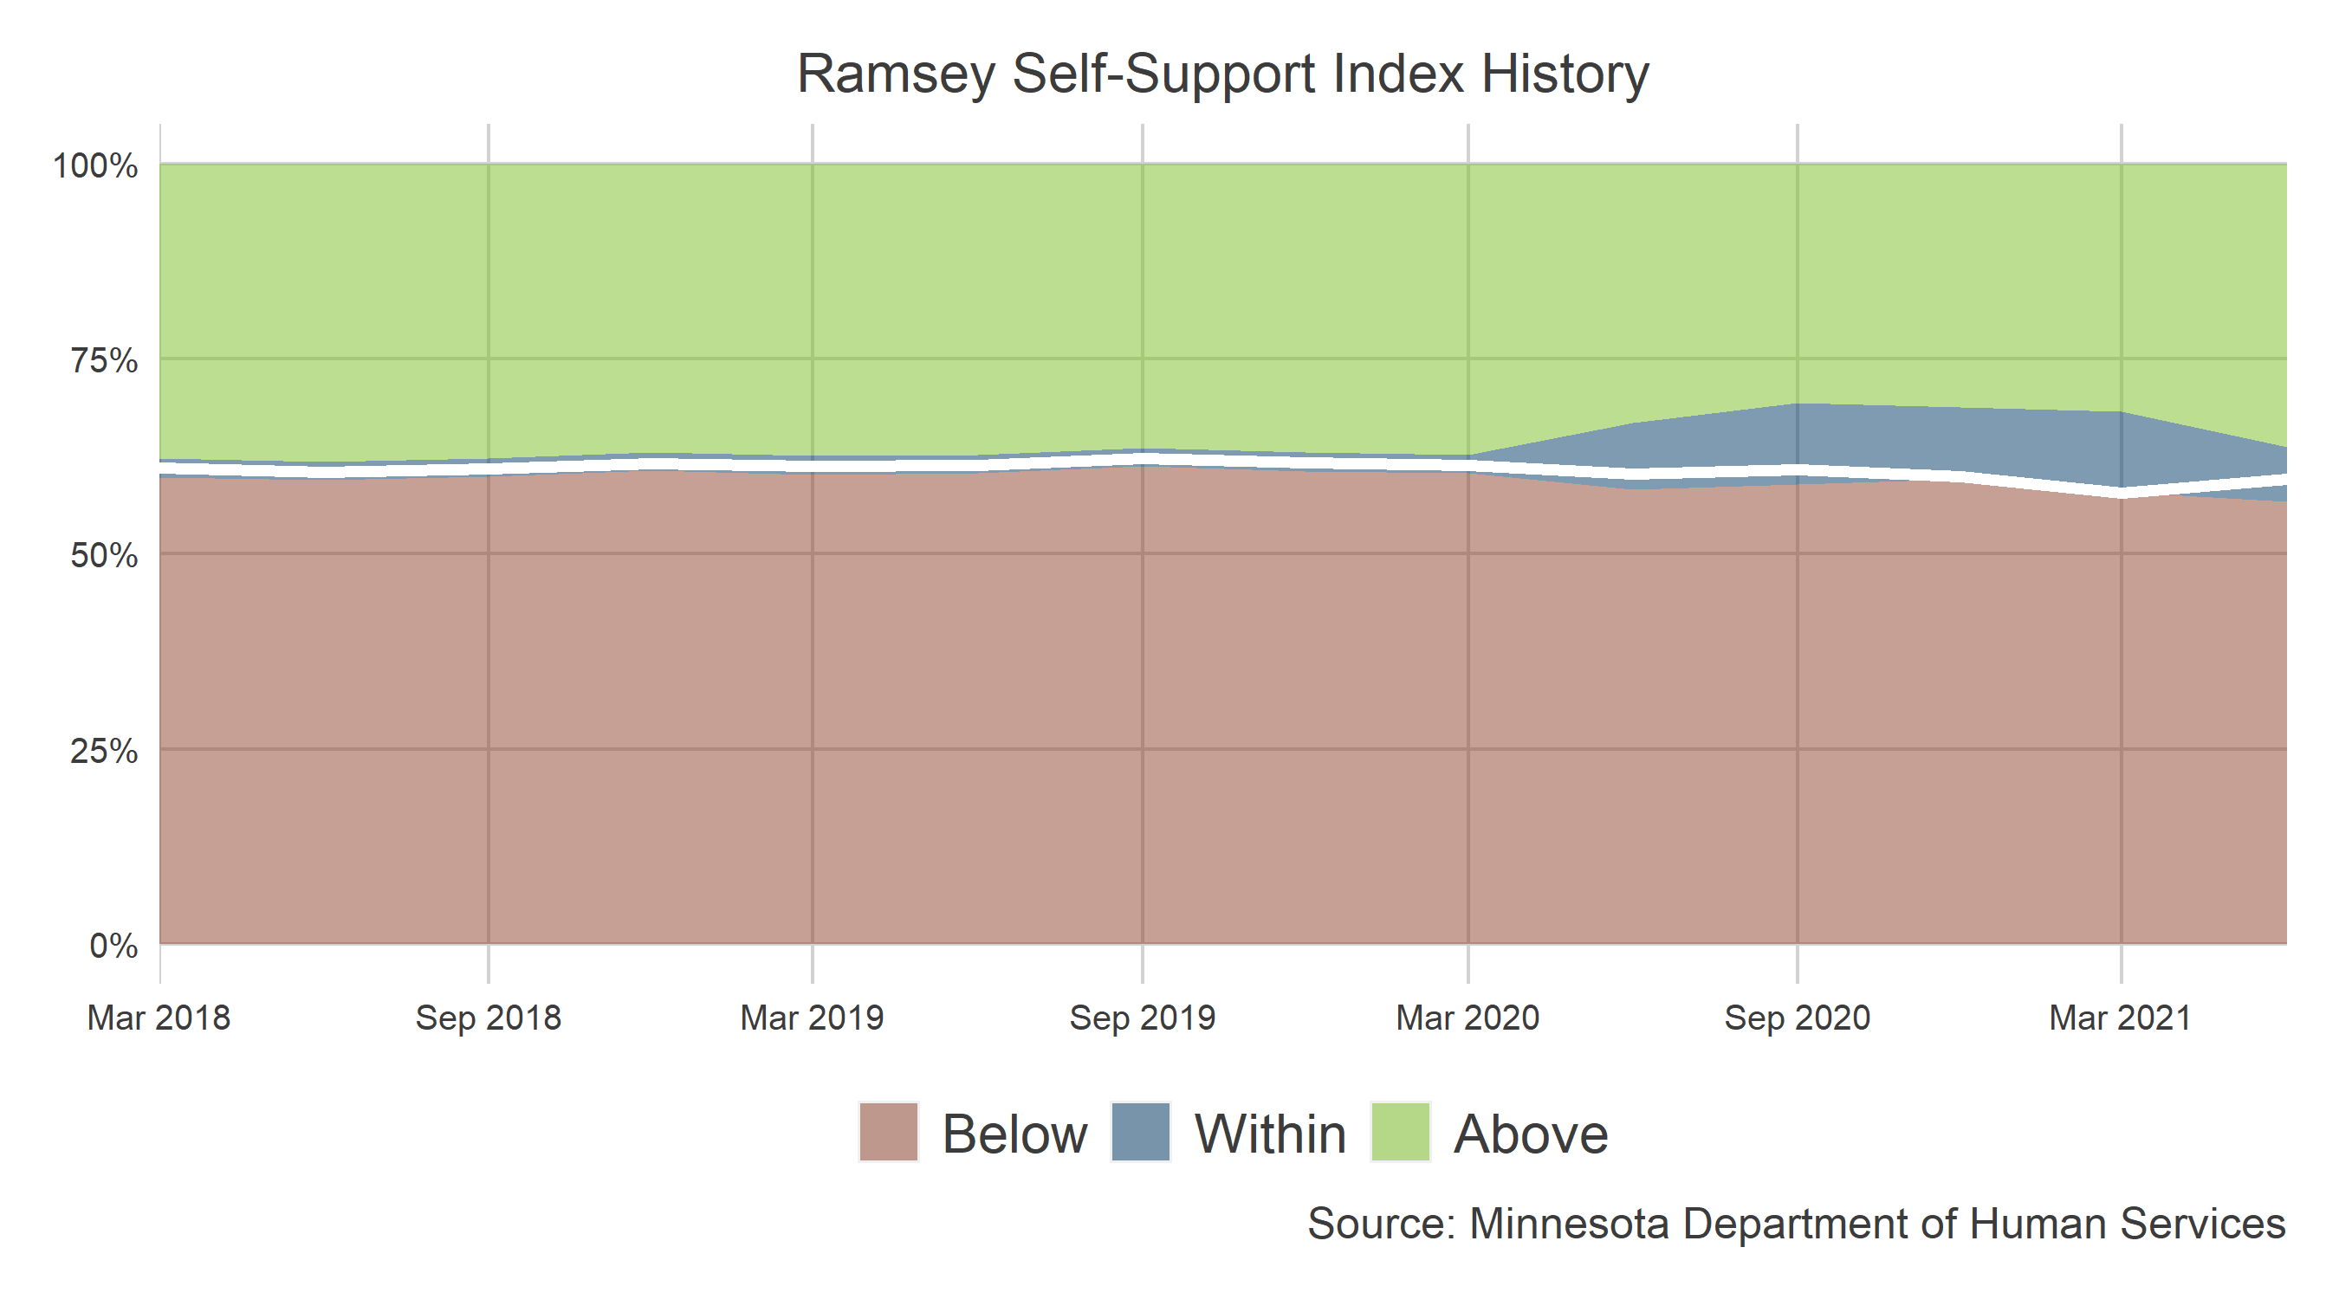
Self-Support Index Results: Ramsey

Slide 25
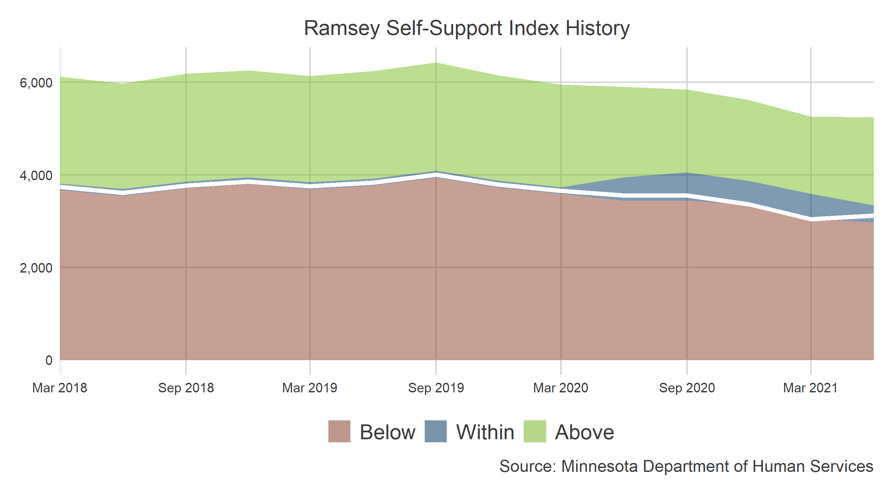
Self-Support Index Results: Ramsey

Slide 26
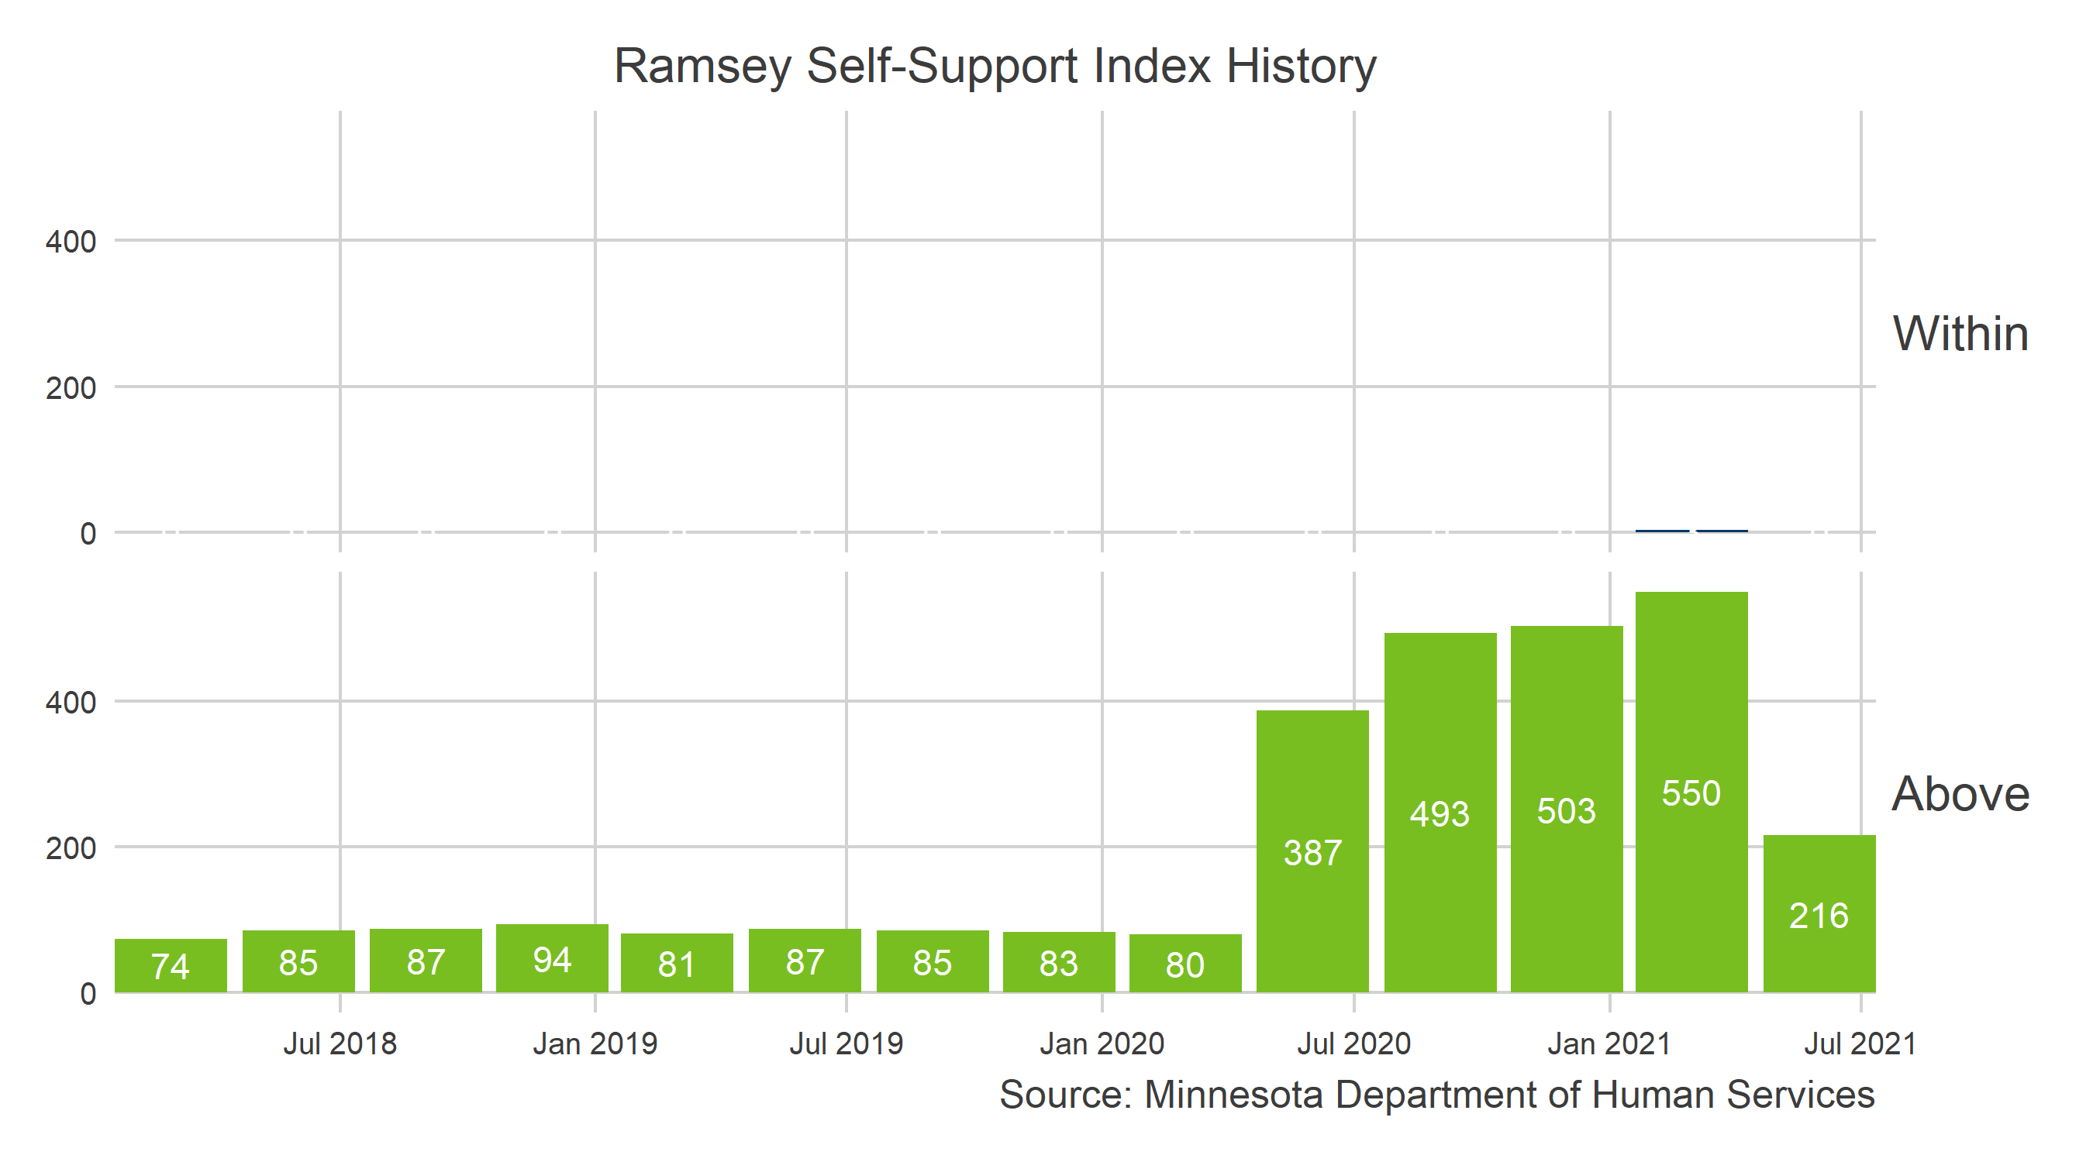
Self-Support Index Results: Ramsey

Slide 27
Self-Support Index for Ramsey
 | Ramsey | Rest of state
African Americans | 40.1% | 23.7%
American Indians | 2.7% | 8.9%
Non-Hmong Asian Immigrants | 7.7% | 0.7%
Months on MFIP | 47.4 | 37.0
MFIP counted months (numeral) | 28.9 | 24.3
Immigrant | 28.1% | 19.1%
Average spell length | 20.2 | 15.2
Hmong | 3.7% | 0.4%
Interpreter services needed | 19.3% | 12.4%
60 counted months | 0.2 | 0.1

Slide 28
Self-Support Index Factors
How do factors affect the score?

Slide 29
Why the Self-Support Index
Developed in response to the Work Participation Rate
Desire to create a measure focused on participant outcomes
Accounts for local conditions outside of the control of agencies
Notes:
The Self-Support Index was created in response to the Work Participation Rate in 2002. The WPR captures the activities of some participants in TANF, but does not measure their outcomes. The state wanted a metric that could meassure outcomes of participants. In particular, outcomes that were align with the goals of TANF: greater self-sufficiency and reduced use of cash assistance. Furthermore, there was an understanding that a single benchmark that didn’t take into account the diversity of the state would be insufficient. They want to have benchmarks that reflected local conditions.

Slide 30
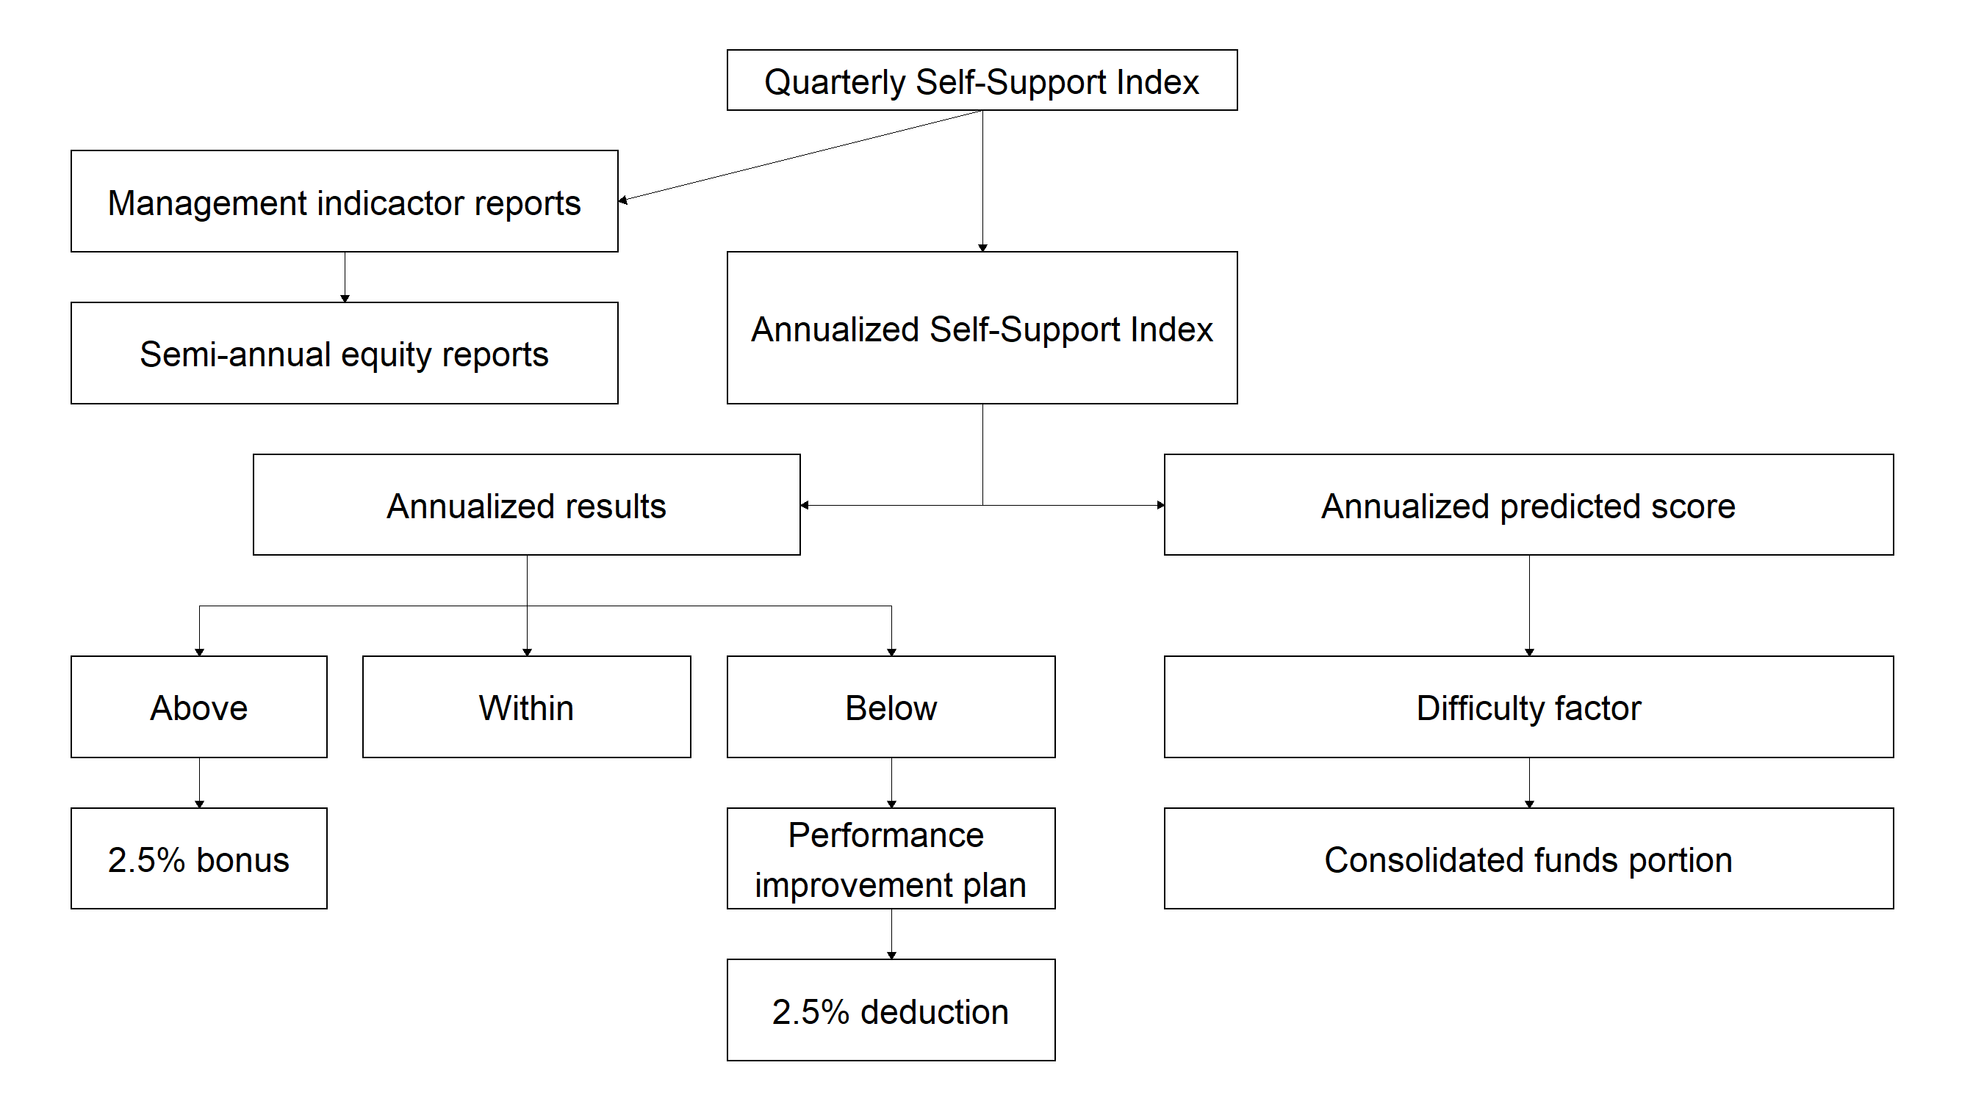
What happens to the Self-Support Index Results

Slide 31
Concerns with the Self-Support Index
What we're heard... | What we're doing...
It doesn’t tell the whole story.‘Off cash assistance’ leaves unanswered questions
It is hard to understand
It is impossible to manage to because the targets change and because it is a measure over so much time

Slide 32
Concerns with the Self-Support Index
What we're heard... | What we're doing...
It doesn’t tell the whole story.‘Off cash assistance’ leaves unanswered questions | Developing supplemental measures to better describe outcomes
It is hard to understand
It is impossible to manage to because the targets change and because it is a measure over so much time

Slide 33
Concerns with the Self-Support Index
What we're heard... | What we're doing...
It doesn’t tell the whole story.‘Off cash assistance’ leaves unanswered questions | Developing supplemental measures to better describe outcomes
It is hard to understand | Provide trainings to describe the measure - We always are open for questions
It is impossible to manage to because the targets change and because it is a measure over so much time

Slide 34
Concerns with the Self-Support Index
What we're heard... | What we're doing...
It doesn’t tell the whole story.‘Off cash assistance’ leaves unanswered questions | Developing supplemental measures to better describe outcomes
It is hard to understand | Provide trainings to describe the measure - We always are open for questions
It is impossible to manage to because the targets change and because it is a measure over so much time | Webi tool and new measures describing the association between agency activities and the index

Slide 35
Self-Support Index Reports
A secure web-based tool that:
Called WEBI or BOBI
Contains data about individuals
Combines data from WF1 and MAXIS
Flexible to customize the information
Refreshes automatically each month so you don’t wait for someone at DHS to post new data
Notes:
As mentioned above, we have recently been working on efforts to improve the Self-Support Index. As a jumping off point, we used feedback from local agencies gathered at trainings. The agency collaborated with faculty at the University of Minnesota to review the Self-Support Index and suggest changes. Through that work, new information about participants and communities has been tested in the model. In addition, the researchers suggest different strategies to predict individual likelihood of success and to generate the ranges of expected performance. About a year ago, we gathered local agencies together to share this work. We had hope that this spring we would reconvene to share the planned changes and begin to roll out the impovements to the model. The pandemic has greatly changed our plans and we are working through how to procede. As agency, we are hoping to more actively engage local agencies that are struggling with the Self-Support Index, connecting prior to financial penalties. We have also started a project with two counties and the TANF Data Collaborative to develop a dashboard for local agencies about their TANF program and to explore the relationship between program activities and results on the Self-Support Index.

Slide 36
Self-Support Index Reports
Who is in the tool?
Participants that you are now serving who will be measured in your upcoming reports on the Self-Support Index

Slide 37
Self-Support Index Reports
Data elements | Current | Pervious month | Two months ago | Three months ago
Servicing agency name | ✓
Current month | ✓
Quarter end month | ✓
ES Provider/Agency, Location | ✓
Cash program ID | ✓
FSS indicator | ✓
Sanction Indicator | ✓
Counted MFIP months | ✓
Open education or work experience activity | ✓
Work hours | ✓ | ✓ | ✓ | ✓
Work earnings | ✓ | ✓ | ✓ | ✓

Slide 38
Self-Support Index Reports
Making sense of WEBI/BOBI cohorts | Making sense of WEBI/BOBI cohorts | Making sense of WEBI/BOBI cohorts
Cohort number | What S-SI quarter? | When were they on previously?
1 | Current quarter | Three years ago
2 | Next quarter | Two years three quarters ago
3 | Second quarter from now | Two years two quarters ago
4 | Third quarter from now | Two years one quarter ago
5 | This quarter next year | Two years ago
Notes:
As mentioned above, we have recently been working on efforts to improve the Self-Support Index. As a jumping off point, we used feedback from local agencies gathered at trainings. The agency collaborated with faculty at the University of Minnesota to review the Self-Support Index and suggest changes. Through that work, new information about participants and communities has been tested in the model. In addition, the researchers suggest different strategies to predict individual likelihood of success and to generate the ranges of expected performance. About a year ago, we gathered local agencies together to share this work. We had hope that this spring we would reconvene to share the planned changes and begin to roll out the impovements to the model. The pandemic has greatly changed our plans and we are working through how to procede. As agency, we are hoping to more actively engage local agencies that are struggling with the Self-Support Index, connecting prior to financial penalties. We have also started a project with two counties and the TANF Data Collaborative to develop a dashboard for local agencies about their TANF program and to explore the relationship between program activities and results on the Self-Support Index.

Slide 39
Self-Support Index
Self-Support Index focuses on outcomes of all adults on MFIP or DWP
Range accounts for individual and community factors outside the control of agencies
You can improve the score, not the range

Slide 40
Thank you!
Ben Jaques-Leslie
benjamin.jaques-leslie@state.mn.us

Slide 41
Collaboration and the Self-Support Index
Developed in partnership between the state, local agencies, and academics
Ongoing trainings with local agencies on the measure
Local agencies can access data on participants who will be part of the measure
Incorporating stakeholder feedback into improvements to the model
Notes:
Stakeholder engagement has been a key feature of the Self-Support Index since it’s inception. The measure itself was developed in collaboration between the MN Dept of Human Service, MN Dept of Employment and Economic Development, counties, tribes, employment service agencies, and universities. More recently, state staff have local agencies to train managers and frontline workers on the measure, reaching more than half the state’s counties. The agency has also created a tool that allows local agencies to identify current TANF participants who will be in upcoming cohorts of the Self-Support Index and provides other information about the participants, including demographics, workers, their employment details, and other information. Through the engagement with stakeholders, we’ve developed ideas about how to improved the measure, which I’ll discuss in more detail shortly.

Slide 42
Lessons Learned
Continual engagement with stakeholders is vital
Financial penalties work against collaboration
Not all TANF participants are workers - economic sustainability still matters for them
Incorporate disparities into the model
Measures are tools for learning
All measures are imperfect
Notes:
We’ll conclude with some thoughts on our experience using the Self-Support Index. Most importantly, engaging with stakeholders is very important. The goal of a performance measure is to incentize practitioners to develop ways to improve the program. Understanding the measure is vital to doing this. Also, we have learned so much from engaging, both to improve the Self-Support Index and about the lives of families on TANF. For example, I noticed for one county Somali participants were much less likely to be successful than else where in the state. (Somali immigrants are generally very likely to be successful.) When I trained staff in that county, we learned that a local business that had employed many Somali workers had recently closed.
We have grown very skeptical of using financial penalties. Clearly, financial penalties are meant to incentize improving programs, but what happens in practice is that you take resources away from agencies that are struggling. Collaboration can be very challenging when financial penalties become an option. We are reconsidering this aspect of the program.
This was mentioned above, but it’s important to remember not all TANF participants will be going into the workforce. It’s important to have outcome measures that capture what success might look like to these participants.
That racial disparities are adjust for in the ranges for agencies is very important. This should allow local agencies to invest in supporting marginalized groups. In the Self-Support Index, the success of someone less likely to be successful reflects more strongly on the agency than the success of those likely to be successful.
The range and the model that underlies it can be powerful tools for learning about the program. We can look at the relationships between individual and community factors and success to learn about TANF. We can learn for example that families with members receiving Social Security are less likely to be successful or that having a high school diploma makes it more likely that a participant is successful.
Lastly, no performance measure will be perfect. I admit that sometimes I struggle with complaints about the Self-Support Index that I hear from frontline workers. But their comments are important. It is not a perfect measure. We need a variety of measures to understand the operation of programs and speak to what success on TANF means.

Slide 43
Strengths of the Self-Support Index
Accounts for local conditions
Economic and racial disparities
Measures all adult participants in TANF
Not a subset like the WPR
Not only participants who exit the program
Notes:
There are several strengths to the Self-Support Index. First, a target that accounts for local conditions is very useful. Local agencies support different people and have different local economies. Having a metric that adjusts the target to these factors is very important. The Self-Support Index is also directly responsive to macro trends. Changing economic conditions are reflected to the range - we use local unemployment numbers for the measurement quarter. We also see racial disparities in the Self-Support Index results. Areas that have more participants who face systematic discrimination will have ranges that reflect this. Lastly, the Self-Support Index measures all adults on TANF, not a subset like the WPR, or only participants that exit the program. While the majority of participants who come to TANF are workers and return to the workforce, some use the program as a bridge to other more appropriate income streams like disability.

Slide 44
Challenges with the Self-Support Index
Local agencies find it confusing
Three year measure is hard to change
Not clear how to affect results
Notes:
With that said, there are many challenges to the Self-Support Index. Most importantly, the measure is confusing to many people. Understanding what success means to people on the measure is pretty clear. (Though, many folks will argue wether we have defined success correctly.) Understanding the range is a challenge. It’s creation is a black box to most, even if it is pretty straightforward to data analysts. Local agencies also find the three year interval difficult. The people reported on the program were on TANF three years ago, what about today they say. Of course, some of the people on three years ago are still on. But also more strategic initiatives for new people to exit to sustainable jobs could be a good program to focus on. Lastly, we don’t know exactly how to change the results on the Self-Support Index. We don’t have good evidence that certain activities improve local agency scores.
One technical issue with the Self-Support Index is the composite nature of the outcome makes the association between characteristics and the outcome difficult to interpret. You may have a different relationship between race and exiting the program than you would between race and staying on the program but working 30 hours per week.

Slide 45
Improving the Self-Support Index
Improved predict ranges
New information about participants and communities
Adapted prediction methods
Providing more and better data
Notes:
As mentioned above, we have recently been working on efforts to improve the Self-Support Index. As a jumping off point, we used feedback from local agencies gathered at trainings. The agency collaborated with faculty at the University of Minnesota to review the Self-Support Index and suggest changes. Through that work, new information about participants and communities has been tested in the model. In addition, the researchers suggest different strategies to predict individual likelihood of success and to generate the ranges of expected performance. About a year ago, we gathered local agencies together to share this work. We had hope that this spring we would reconvene to share the planned changes and begin to roll out the improvements to the model. The pandemic has greatly changed our plans and we are working through how to precede. As agency, we are hoping to more actively engage local agencies that are struggling with the Self-Support Index, connecting prior to financial penalties. We have also started a project with two counties and the TANF Data Collaborative to develop a dashboard for local agencies about their TANF program and to explore the relationship between program activities and results on the Self-Support Index.

